Slide 1
Understanding the Athletic Mindset: Engaging faculty who strive to engage their students.
Ed Garrett, PsyD, CC-AASP
Belhaven University

Slide 2
The Athletic Mindset
So where are the challenges for non-athletic faculty?
Objective
Discuss past research on the student-athlete mindset as it relates to college.
Hear from our student-athletes in order to gain knowledge into their world.
Share past experiences with the cadre.
Best practice discussion.

Slide 3
The Athletic Mindset
The life of a student:
Attend classes regularly
Study 2-3 hours each day
Enjoy a healthy social life
Eat
Sleep
Take care of basic human needs
The life of a student-athlete:
Attend classes regularly
Study 2-3 hours each day
Enjoy a healthy social life
Eat
Sleep
Take care of basic human needs
Attend 3-5 hours a day of practice
Attend weekly required meetings
Attend weekly workout programs
Many of these student-athletes have placed their identity in their sport for the past 13-14 years. It has become the one
constant in their lives.

Slide 4
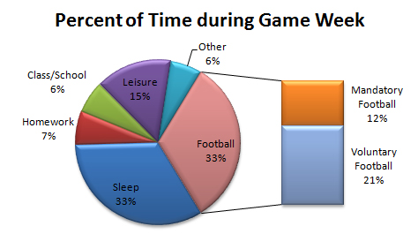
The Athletic Mindset

Slide 5
The Athletic Mindset
What are student-athletes (SA) thinking when it comes to school?
SA’s that aspire to a professional athletic career (FB,BSK,BS) may be distracted from thinking about alternative career options while still in college (Cox, Sadberry, McGuire, & McBride, 2009).
Lally and Kerr (2005) reported that the typical pattern for a SA is to begin their college careers having no clear ideas about life after sports.
Martin (2000) concluded that the student’s sense of competence and purpose is strongly related to student-faculty interaction.
Notes:
For most, not all, their identity has been centered on their sport. To shift that mentality to a career path that academics will provide is difficult and takes cultivating.

Slide 6
The Athletic Mindset
A brief survey of student-athletes was conducted recently. The topic of student-athletes and faculty were presented. The results are presented in a qualitative nature in order to capture the student-athlete’s lived experience.
Participants (n = 93) were broken down into four different years in school (FR 15, SO 14, JR 24, SR 40) and by sport (NAIA).

Slide 7
The Athletic Mindset
Do you feel that professors, in general, understand the life of a student-athlete?
Why?

Slide 8
The Athletic Mindset
Have you witnessed one of your non-athletic course faculty attending one of your competitions?

Slide 9
The Athletic Mindset
Have one of your non-athletic course professors commented to you about your participation in a competition?

Slide 10
The Athletic Mindset
What is one thing a professor can do to help you be a successful student-athlete?
64% of the student-athletes surveyed used one main theme: UNDERSTAND
Understanding implies a level of empathy into
what a university is asking a student-athlete to be.

Slide 11
The Athletic Mindset
Thoughts
We must allow for a grieving process to take place.
It is a self-focused professor that does not take the time to know his or her student’s stories.
If we do not begin to see our role as “coach” than student-athletes will fail to see their role as a “team player.”

Slide 12
The Athletic Mindset
Questions that need to be asked
-What does this data say? Better yet, what are the SA’s saying?
-(Non-Athletic Discipline) If this were a student in our major would we handle it differently?
-As faculty we are always seeking excellence. How can we relate the excellence in the classroom to the excellence on the ball-field to excellence in life?
- Would this data be different between NCAA I and NCAAIII?

Slide 13
The Athletic Mindset
Best Practices
“One coach will impact more young people in a year than the average person.” – Rev. Billy Graham
What practices can we share with fellow non-athletic faculty that will help them become “coaches” of education?

Slide 14
The Athletic Mindset
Thank you for your time
Ed Garrett, PsyD, CC-AASP
Belhaven University
egarrett@Belhaven.edu
601.667.9706

