Slide 1
Using Student Advisory Boards to
Enhance Learning & Program Assessment in Sport Management
Simon M. Pack
Spencer C. Peek
St. John’s University

Slide 2
In A Nutshell
“Tell me and I forget. Teach me and I remember. Involve me and I learn”
Benjamin Franklin

Slide 3
Advisory Boards
Group of individuals brought together to help an institution better achieve its mission and goals
Provide the following resources to their organizations:
legitimacy
resources
market intelligence
access to data
expertise
industry reach
(Zahra et al., 2011)

Slide 4
Industry/Professional Advisory Boards
Not a novel concept within Sport Management academic programs
Recognized within COSMA
Job/Internship benefits
Programmatic input
Enhance engagement
Assessment

Slide 5
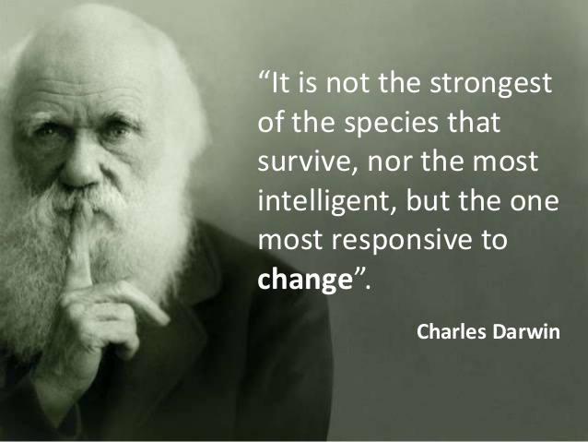
Impact of Current Trends
Cost of higher education
Enrollment numbers
Private v. Public
Retention
Non-traditional students
Online education
Workforce development

Slide 6
Student Advisory Boards
Took hold in the field of Library Sciences
Direct “user” feedback
Goal was to build more student-centered libraries/common spaces
Acting on evidence-based user feedback

Slide 7
Student Engagement
How can we continue to engage students through interesting and unique ways …. high impact practices

Slide 8
Valuable…but challenging
Recruitment
Representation
Turn-over
Sharing of results
Implementation
Measuring effectiveness
“This is an opportunity to turn a complainer into a champion….”
(Farrell, 2011)

Slide 9
Board of Sport Management Students

Slide 10
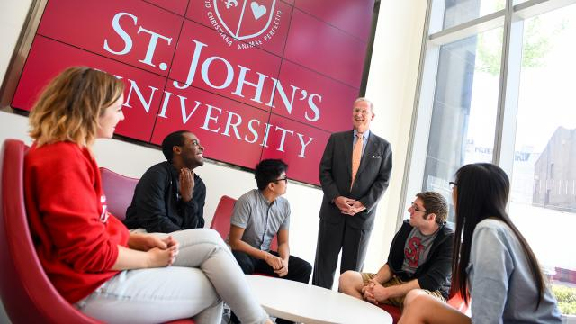
Focus Group Interviews
Programmatic issues
Job/internship search
Transfer requirements
Experiential and Service Learning Opportunities
Entry-level job preparedness
Networking
Career Services
Graduate education

Slide 11
Practical Implications
Soliciting feedback directly from students
Implementing change…
We have the mechanism…but are we really listening?
Using feedback to improve programs
How much can really be changed?
Should the largest user group (students) have the least feedback?
Faculty and Sport Management Academic programs as gatekeepers?

Slide 12
Thank you!
Questions?
spencer.peek19@my.stjohns.edu
packs@stjohns.edu

