Slide 1
Understanding the choice of seeking or not seeking COSMA Accreditation. What are the implications of this choice?
Cheryl R. Rode
Janet M. Howes

Slide 2
Sport Management Programs in the United States
 | Undergraduate | Masters | Doctoral | Total
NASSM | 461 | 260 | 38 | 542
COSMA | 34 | 20 | 3 | 57*
*Some institutions have more than one program at an academic level
(Data collected from NASSM and COSMA websites, June 2021)

Slide 3
History of Sport Management Programs
American Alliance for Health, Physical Education, Recreations and Dance (AAHPERD) and National Association for Sport and Physical Education (NASPE) worked to streamline curriculum
North American Society for Sport Management established a set of review standards
COSMA was eventually created to construct continuity within sport management programs and curriculum through accreditation
(“About COSMA”, 2021; Case, 2014; Force, 1993)

Slide 4
Why achieve accreditation status?
Rigorous process to provide highest quality of sport management curriculum
Learning outcomes
Best practices
Professional preparedness
Experiential learning
(Brown, Willett, Goldfine & Goldfine, 2018; Laird, Johnson & Alderman, 2015)

Slide 5
Our Study
The current study is ‘in progress’
Semi-structured interviews
Selection process
Questions asked about COSMA accreditation status, faculty, etc.

Slide 6
Population

Slide 7
Participant | Type of University | Program Housed | # of Students | COSMA Accredited? | # of Faculty
Bailey | 4-year private college NCCAA DI & NCAA DIII | Health and Physical Ed Dept | 40 | Yes | 4
Oliver | 4-year private, not-for-profit coed institution – DIII Athletics | Business Administration | 265 | Yes | 6
Lily | 4-year public university – part of a large University state system – DI athletics | Dept of Kinesiology | 450 | No | 10
Duck | 4-year private liberal arts college – DIII athletics | College of Business | 45 | No | 1
Techie | 4-year public research university - R1, D1 | School of Kinesiology | 120 | No | 9
Goldfish | 4-year public university, DII athletics | College of Health Studies | 219 | Yes | 4

Slide 8
Participant | Type of University | Program Housed | # of Students | COSMA Accredited? | # of Faculty
Jennifer | 4-year private university – DII athletics | College of Business | 71 | No | 1
Tanner | 4-year public research university – RI - DI | College of Business | 311 | Yes | 5
Ed | 4-year private college, DIII | College of Sport Sciences | 125 | Yes | 4
Steven | 4-year private university, RI, DI | College of Prof Studies | 305 | No | 10
Doctor | 4-year public university, DI & DII | Sport Studies | 120 | No | 6
Craig | 4-year private university, DI | School of communications | 200 | In process | 6
Abigail | 4-year university, DIII | Health and Fitness Studies | 30 | In process | 2

Slide 9
Findings
Participants stated:
Pro Accreditation:
Program uses the accreditation in marketing at the university
Accreditation helps with recruitment
Holds program to standard of excellence
“By getting accredited within our program, we thought it would bring some validity and some alignment that students and parents are looking for.”

Slide 10
Findings
Participants stated:
Con Accreditation:
No programs at school are accredited unless needed for licensure
There's no value to it, it's just a lot of work, and the industry doesn't care
Financially difficult
“We initially looked at COSMA accreditation, and then, I think, the decision was well we're in the School of Business, so we've got School of Business accreditation, we don't need to worry about COSMA.”

Slide 11
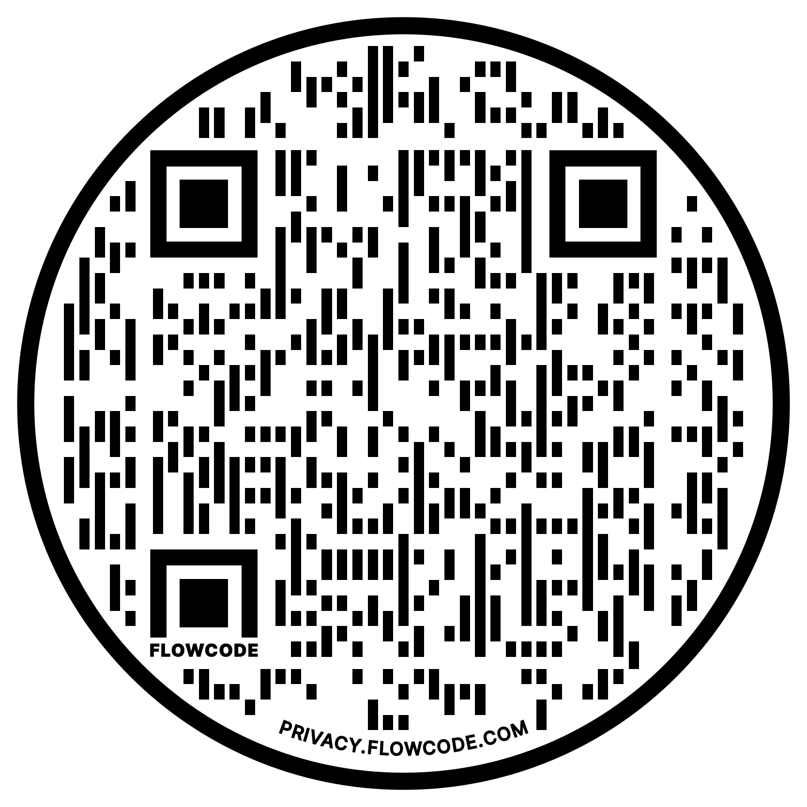
Want to participate?
Please participate by emailing us or scan the QR Code
Cheryl R. Rode
crode@niagara.edu
Janet M. Howes janethowes@usj.edu

Slide 12
References
About COSMA. (2021). Retrieved from COSMA: https://www.cosmaweb.org/
Brown, C., Willett, J., Goldfine, R., &amp; Goldfine, B. (2018). Sport management internships: Recommendations for improving upon experiential learning. Journal of Hospitality, Leisure, Sport & Tourism Education, 22, 75-81.
Force, N. N. J. T. (1993). Standards for curriculum and voluntary accreditation of sport management education programs. Journal of Sport Management, 7(2), 159-170.
Laird, C., Johnson, D. A., &amp; Alderman, H. (2015). Aligning assessments for COSMA accreditation. Journal of Physical Education, Recreation & Dance, 86(8), 27-33.
NASSM Academic Programs. (n.d.). Retrieved from North American Society of Sport Management: https://www.nassm.com/Programs/AcademicPrograms

Slide 13
Questions?
Cheryl R. Rode
crode@niagara.edu
Janet M. Howes
jhowes@usj.edu

