Slide 1
Implementing Service Learning through a Non-Profit Organization
Dee Jacobsen, Ph.D.
Assistant Professor, Professional Practice

Slide 2
School of Kinesiology
SPORT ADMINISTRATION
Athletic Training
Kinesiology
Fitness Studies
Health & PE
Physical Activity & Health
Human Movement Science

Slide 3
Presentation Outline
Sport Administration curriculum
Service learning - define and describe
Building the service learning course
Student and community benefits

Slide 4
Sport Administration Curriculum
Emphasis on gaining practical experience
Hands-on assignments/projects in coursework
Professional enhancement
Community service - **Service Learning
Volunteerism
Extended education
Independent studies (mini-internships) encouraged
Internships

Slide 5
What is Service Learning?
Pedagological method in which student learning is facilitated by engagement in community service experiences (Butin, 2003)
Distinguished from:
volunteering by emphasis on academic learning objectives (Hendricks & Miranda, 2003)
internships by its focus on community service (Cipolle, 2004)
Characterized by a balance between service and learning such that both student and agency benefit from the project (Weinreich, 2003).

Slide 6
Service Learning Teaching & Learning Strategy
Integrates meaningful community service
Provides instruction and reflection to enrich the learning experience
Service learning is associated with enhancements in both academic skills and social and emotional development (Ottenritter, 2004)
Teaches civic responsibility
Often linked to the development of citizenship skills and a sense of social justice (Cipolle, 2004)
Strengthens communities

Slide 7
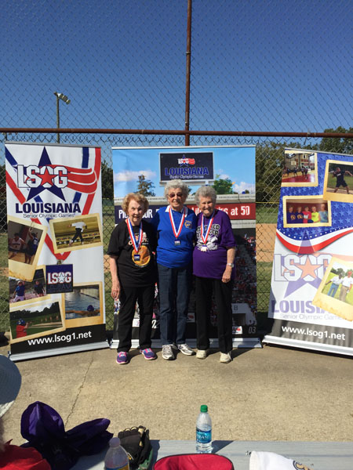
“Win-Win”
Recognized potential for a cooperative partnership with reciprocal benefits and learning for all involved
Well supervised, established non-profit organization
Growth potential, but little or no budget
Program could benefit from student expertise
Practical applied learning opportunity for students

Slide 8
Building the Service Learning Course
Academic Service-Learning Components
Selecting Community Partners
Role Clarification (responsibilities related to student involvement in the community as part of service-learning course)

Slide 9
Academic Service-Learning Components
Relevant & meaningful service
Resource to improve quality of life in community as well as to stimulate student academic and civic learning
Mutual exchange between the community and students
Incorporates the School of Kinesiology’s mission & goals
Incorporates the Sport Administration mission and student learning outcomes

Slide 10
Selecting a Community Partner
Involve partner(s) in identifying needs
Articulate criteria for selection of community activities and duration of activities with partner
Provide opportunity for students to be exposed to and come in contact with diverse populations

Slide 11
Partnership

Slide 12
LSOG – Louisiana Senior Olympic Games
Non-profit organization
Identification of needs
Spent one year meeting with Director of Operations exploring ideas and options
Exposed students to realities of community service (limited resources, reliance on volunteers, etc.)
Exposed students to community needs within a specific population
Senior Population (50+)

Slide 13
http://www.lsog1.net/

Slide 14
Role Clarification
Orientation of students to agency
Preparation and training of students for the work they will be undertaking
Supervision of the students at the agency
Communication methods between the faculty member and the community partner during the semester
Confirmation that the students were diligent in their responsibilities

Slide 15
Recognition as Service-Learning Course
Official LSU service learning course
Center for Community Engagement, Learning & Leadership (CCELL)
SPADM Course:
KIN 4517 – Sport Administration
Partnership
Louisiana Senior Olympic Games (LSOG)

Slide 16
KIN 4517: Sport Administration
Course Content:
Principles of management, sport applications of the principles and skill development
Lecture/guest speakers/skill building exercises
Acquisition of skills
Skill development – the difference between learning about management and learning to be a sport manager
Service learning
Opportunity for application at it’s best
Fill gap in curriculum
Seek out practitioners

Slide 17
Student Learning Outcomes
Demonstrate an understanding of how to identify problems and make sound decisions in a variety of settings within the organization
Gain experience with interpersonal communication skills with individuals and groups and increase knowledge of disseminating information in various formats to diverse populations
Develop an awareness of diverse social and cultural populations, perspectives and their impact on an informed lifestyle as it pertains to sport management

Slide 18
Student Requirements
Office experiences at LSOG headquarters
2 hours per week for 7 weeks (total of 14 hours)
Assist an event coordinator at one of the designated events at the LSOG State Games
hours varied depending on the event
Daily log
Development of a strategic management plan for the organization (as a class)
Evaluation Process
Supervisor feedback and evaluations
Administrative hours
Actual event
Reflections

Slide 19
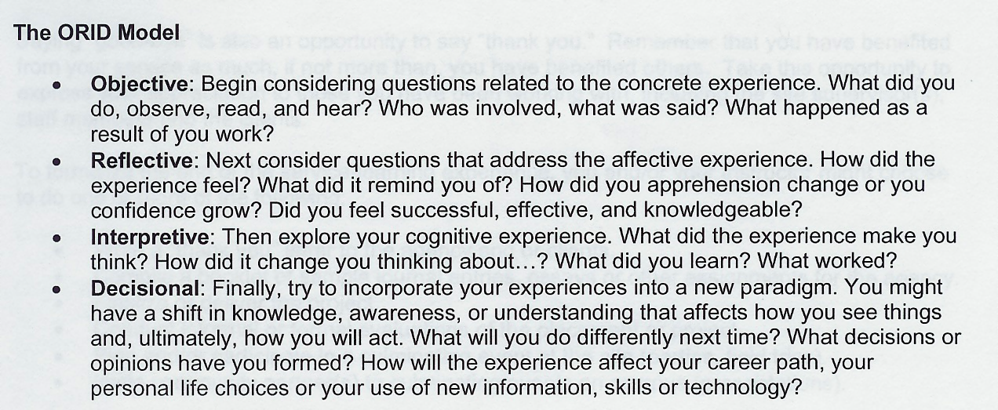
Reflections
This component was designed to aid the students in thinking about their experience and ultimately connecting their experience with the learning outcomes of the course.

Slide 20
Example of Reflection Component
In this reflection paper you will be asked to consider several issues as it pertains to the LSOG event you worked. Capture the entire experience in your reflection – from office hours at LSOG to the actual event itself and all the work in between. Provide rich descriptions and examples when possible.
Re: Communication and Relationships
What have you learned about working with others (your classmates, LSOG personnel, senior athlete population)? How have you improved your communication effectiveness?
Re: Personal Development (managing/administrative style)
What have you discovered about your strengths? What are your weaknesses and what is your plan for improvement? What have you learned about developing your own style of managing?

Slide 21
Student and Community Benefits

Slide 22
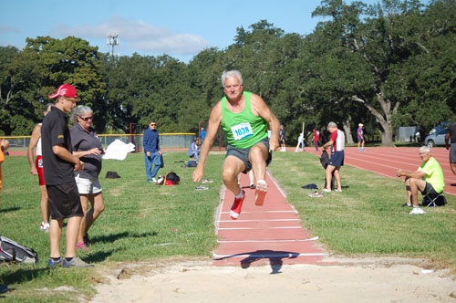
LSU Student Learning at LSOG
Professional mentoring
Practice management skills
Interaction with seniors
Developing communication
Interpersonal skills
Community engagement/networking
Event Management experience

Slide 23
Benefits for Agency/Community
Many agencies operate under tight budget constraints and/or limited human resources
University faculty and students may have specialized knowledge and skills that benefit the agency (Taylor et al., 2004).

Slide 24
Benefits to LSOG
Program diversity
Students bring own experiences/expertise (marketing, event management, social media, etc.)
Fresh, creative ideas
Developed strategic management plan
Expansion
More events scheduled
Allows Director of Operations freedom

Slide 25
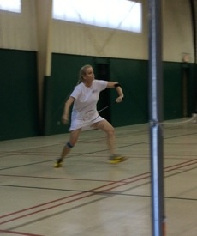
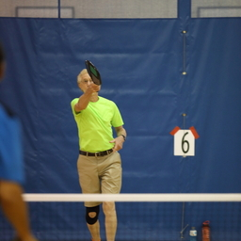
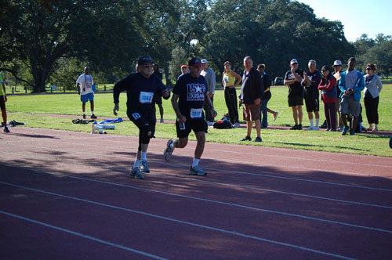
PICKLEBALL
BADMINTON
TRACK & FIELD

Slide 26
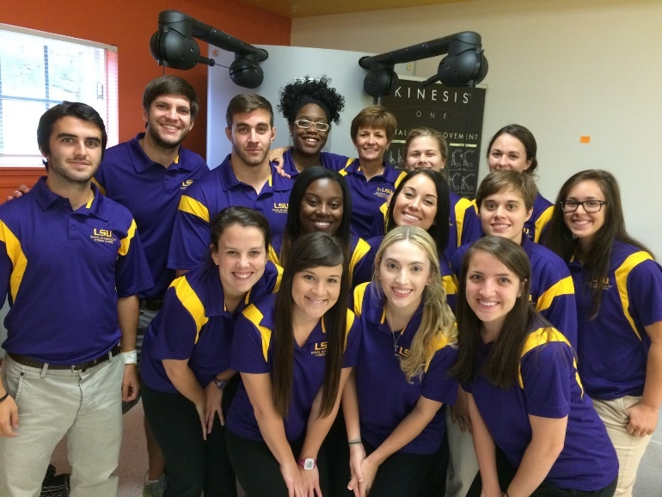
Student Feedback
Reflections indicate that this experience…
enhanced my appreciation for current concerns and needs in the community
helped me recognize how my knowledge, skills and abilities can have a significant, positive impact on the lives of older populations
gained better appreciation for my civic responsibility as a professional in the sport industry

Slide 27
Thank you…Questions?

