Slide 1
Fostering Best Practices and Intentional Experiential Learning Opportunities
Michael Ross, Sport Management Department Chair – Shorter University
Heath Hooper, Dean of the College of Business – Shorter University
Kyle Conkle, Assistant Professor of Sport Management – Shorter University

Slide 2
The Standard:
#1 – Continually improve our programs to be the best version possible.
2017 - #29 Online BBA Sport Management Program
2022 & 2023 - #1 Online BBA Sport Management Program
#2 – Serve our students to the greatest level possible.
Educate and prepare them for their goals.

Slide 3
Background and Intention of Program Design
Origin of restructuring and design: “Don’t get us fired”
Poll Industry Professionals: What do you need?
Experience
Skills
Communication
Professionalism
Maturity
Passion

Slide 4
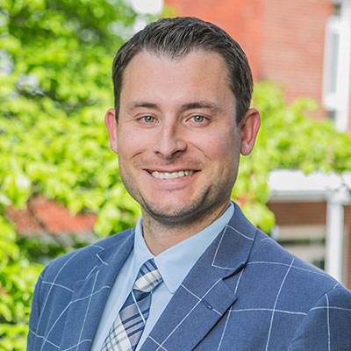
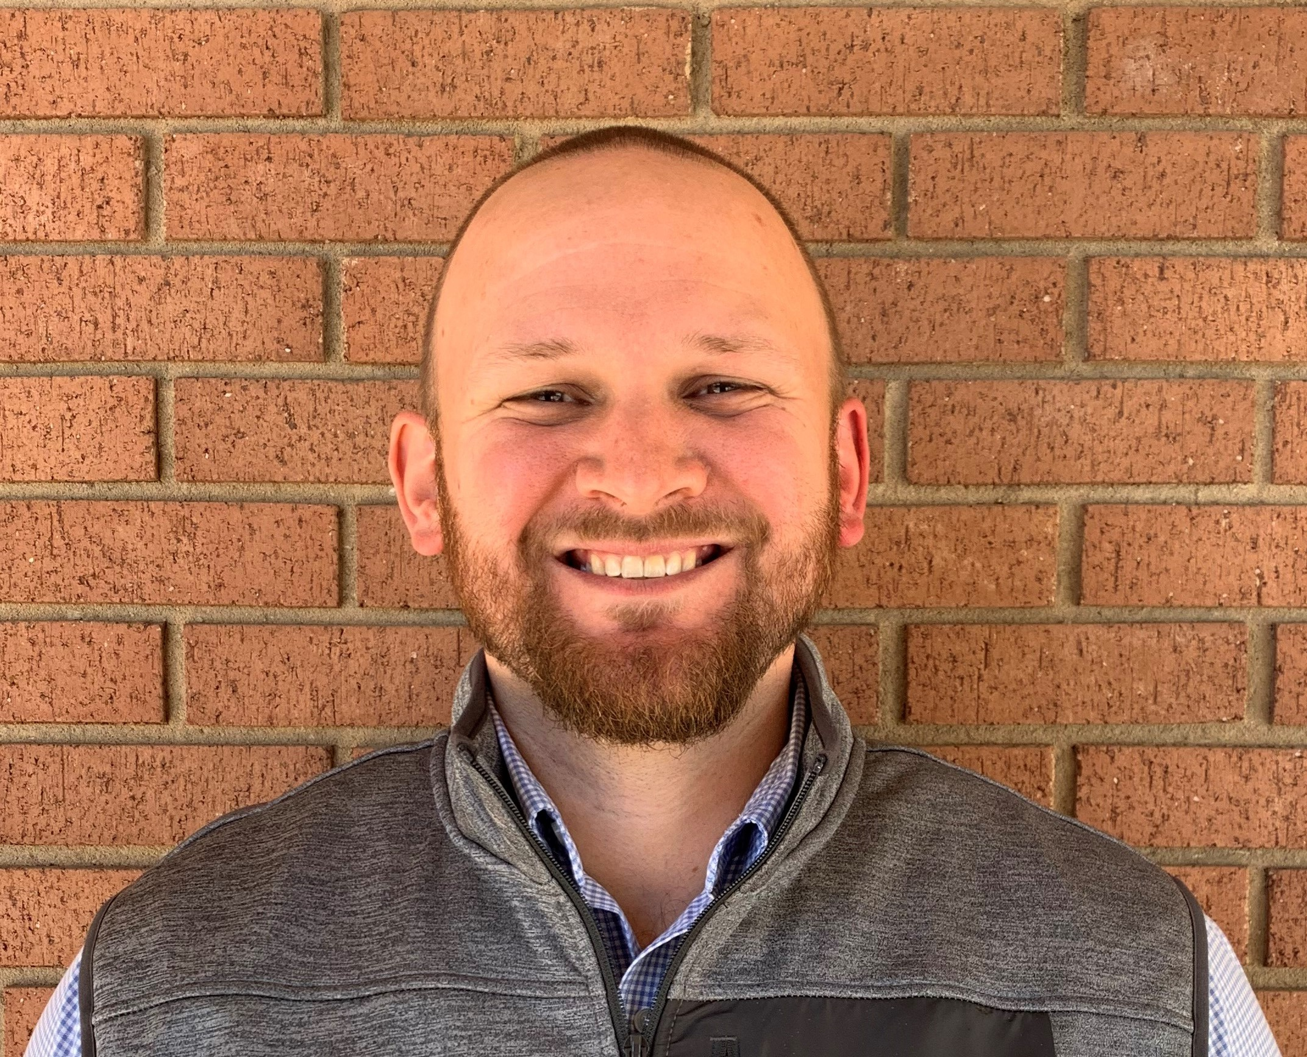
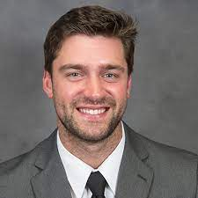
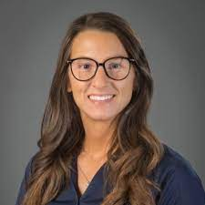
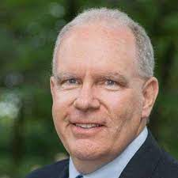
Intentional Hiring of Faculty
Dr. Hooper – Dean
Intercollegiate coaching
Professor Ross – Department Chair
Athletic Administration/Youth Development Company
Professor Conkle – Assistant Professor
Intercollegiate E&F Operations
Professor Romano – Assistant Professor
Intercollegiate Recreation/Sales
Dr. Hart – Assistant Professor
Commissioner of USA South Conference

Slide 5
Required 12 Credit Hour Internship
Required 12 Credit Hours (500 total on ground hours)
Optional Routes to complete
All 500 hours during a singular 16-week semester.
Divide internship in half and complete two separate 6 credit hours (250 on ground hours) over two independent 16-week semesters.
Talking Points:
Application and approval process
Student situation
Intentionality and reasoning for desired internship
Goal setting before start date
Realistic expectations

Slide 6
Focused Interview Assignments
Conducted over four separate courses and are course specific*
SPM 1500* - Intro to Sport Management
SPM 3500 – Sport Coaching
SPM 3700 – Sport Administration
SPM 3800 – Sport Governance
Focus:
Networking
Communication
Question formation
Knowledge sought/intentionality

Slide 7
Integrating Volunteer Experience/Service
Built in as an assignment in a few 3000 level courses aimed at 1) gaining volunteer experience to better understand passion and 2) additional networking.
Students are allowed and encouraged to find an opportunity of their choosing with considerations:
Event must be intentional, and they must provide rationale as to why they believe said event to be beneficial.
Networking, skill development, or community service must be evident.
Guidelines for recap and accompanied presentation must be met.
Result: Many students have acquired internships, part-time and full-time job opportunities from this singular assignment and how they conducted themselves.

Slide 8
NCAA DII – Athletic Department Experience
Opportunity: DII athletic department desired/needed additional human resources and help to facilitate games and other athletic specific events.
We integrated Volunteer/Experiential learning assignments in our Event & Facility and Senior Capstone courses to assist.
Benefits:
Required number of events can fluctuate based on athletic needs prior to semester, number of students enrolled in course, etc.
Athletics receives needed help, students receive hands on NCAA DII game day and event management operations and management experience.
Outcomes:
Our current SID and Assistant Compliance Officer have transitioned from our program, taking part in these assignments and ultimately into their new roles.

Slide 9
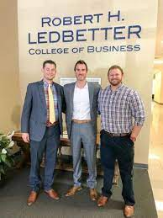
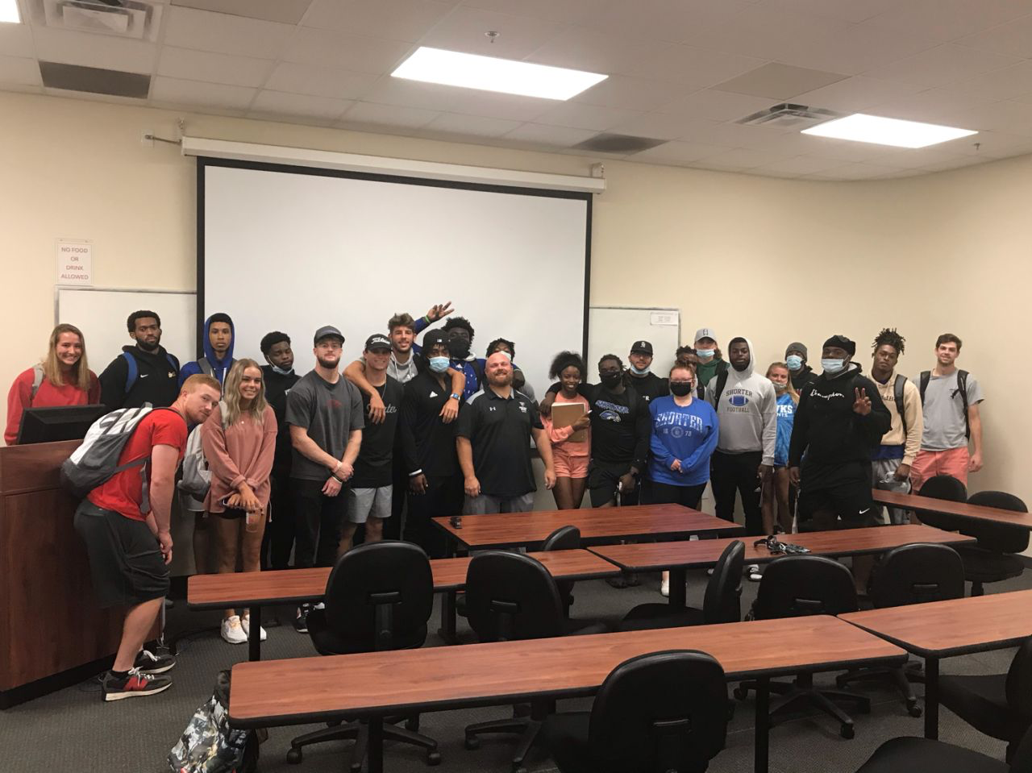
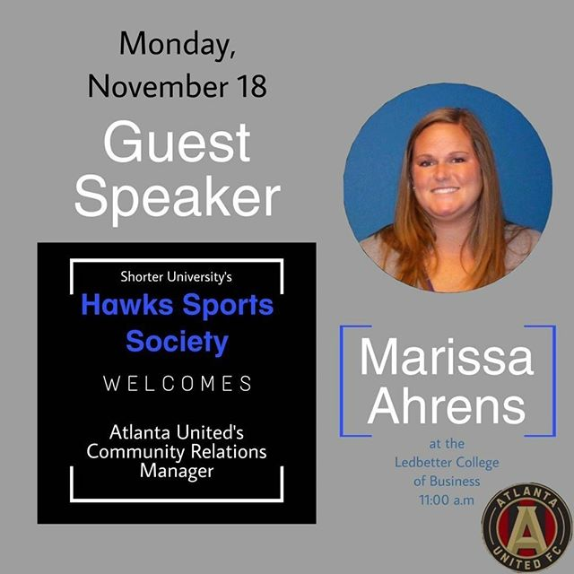
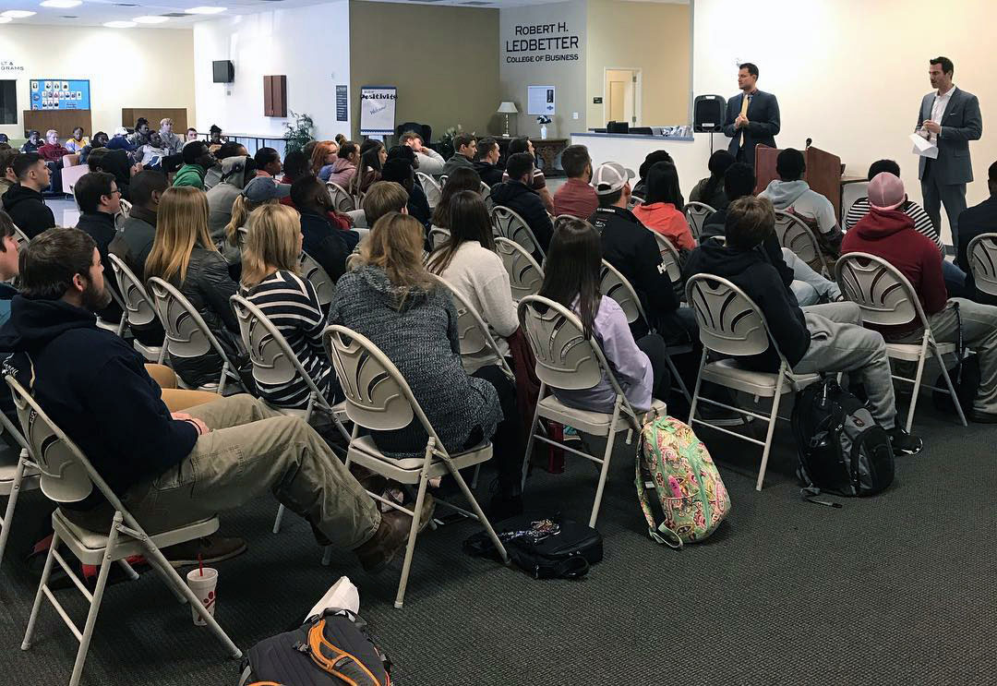
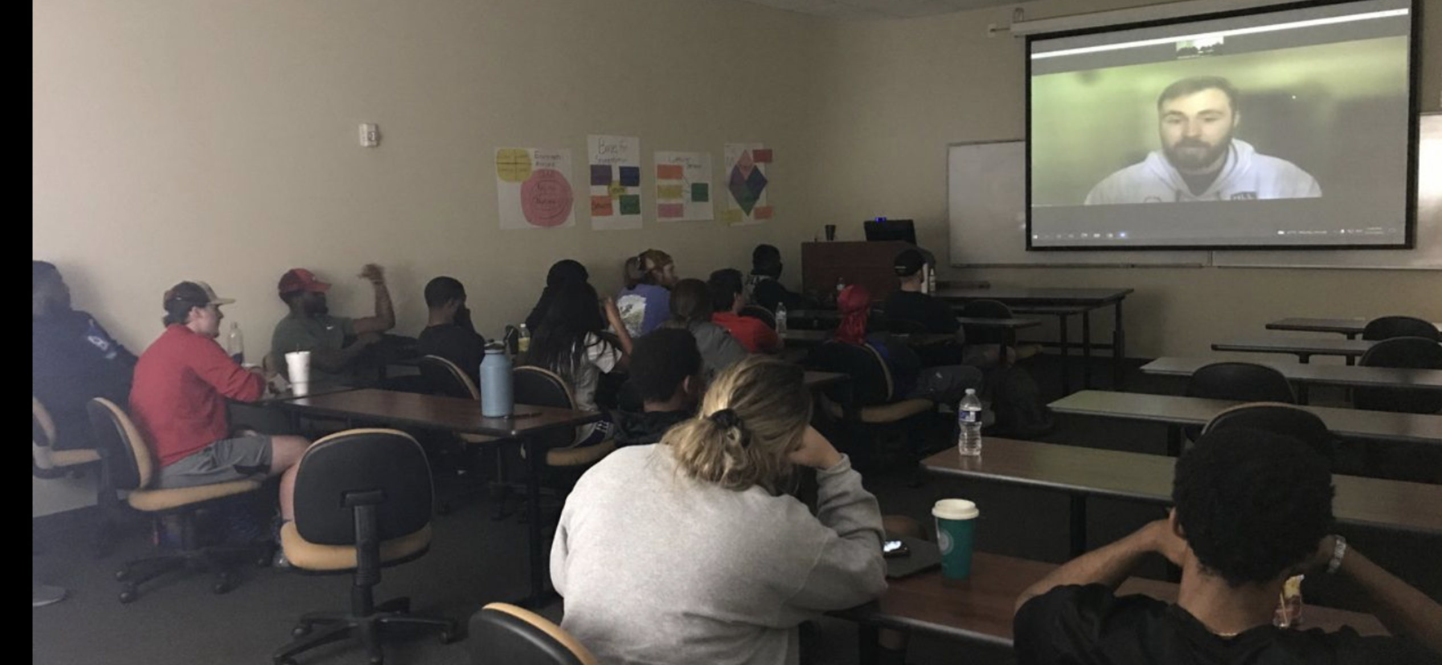
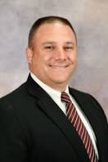
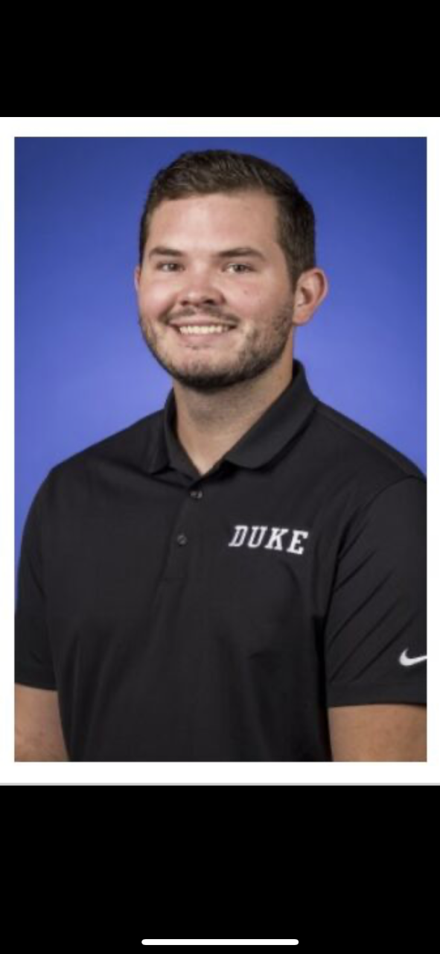
Guest Speakers: Industry Professionals
Purpose: “Be blunt and help us prepare them.”

Slide 10
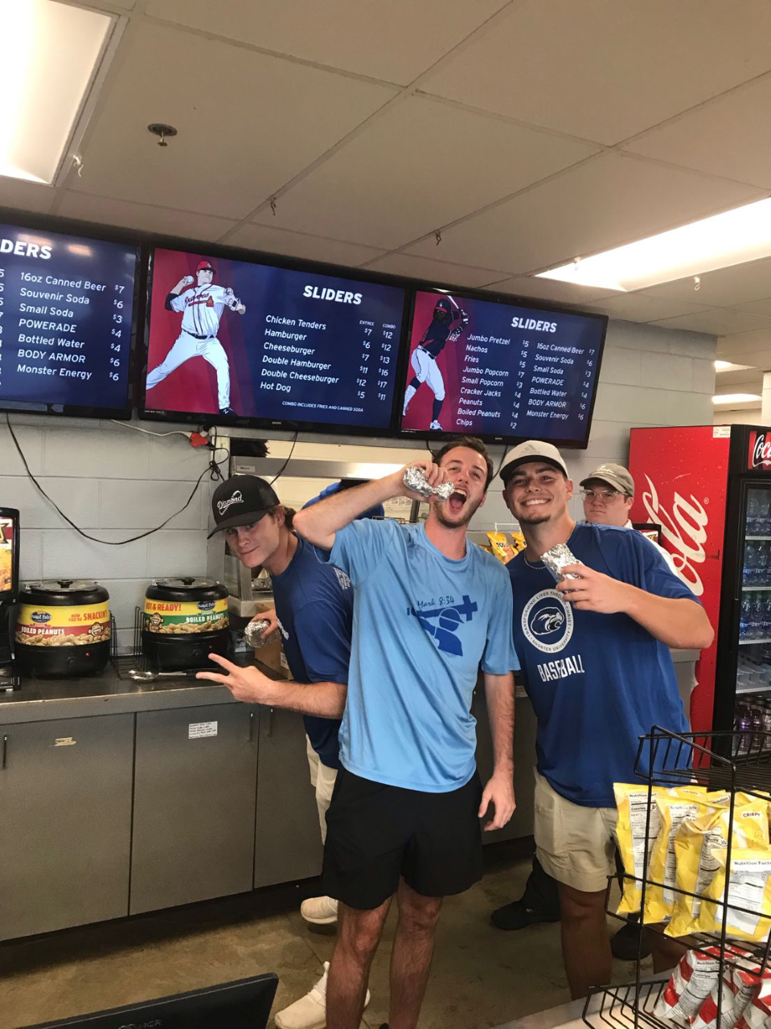
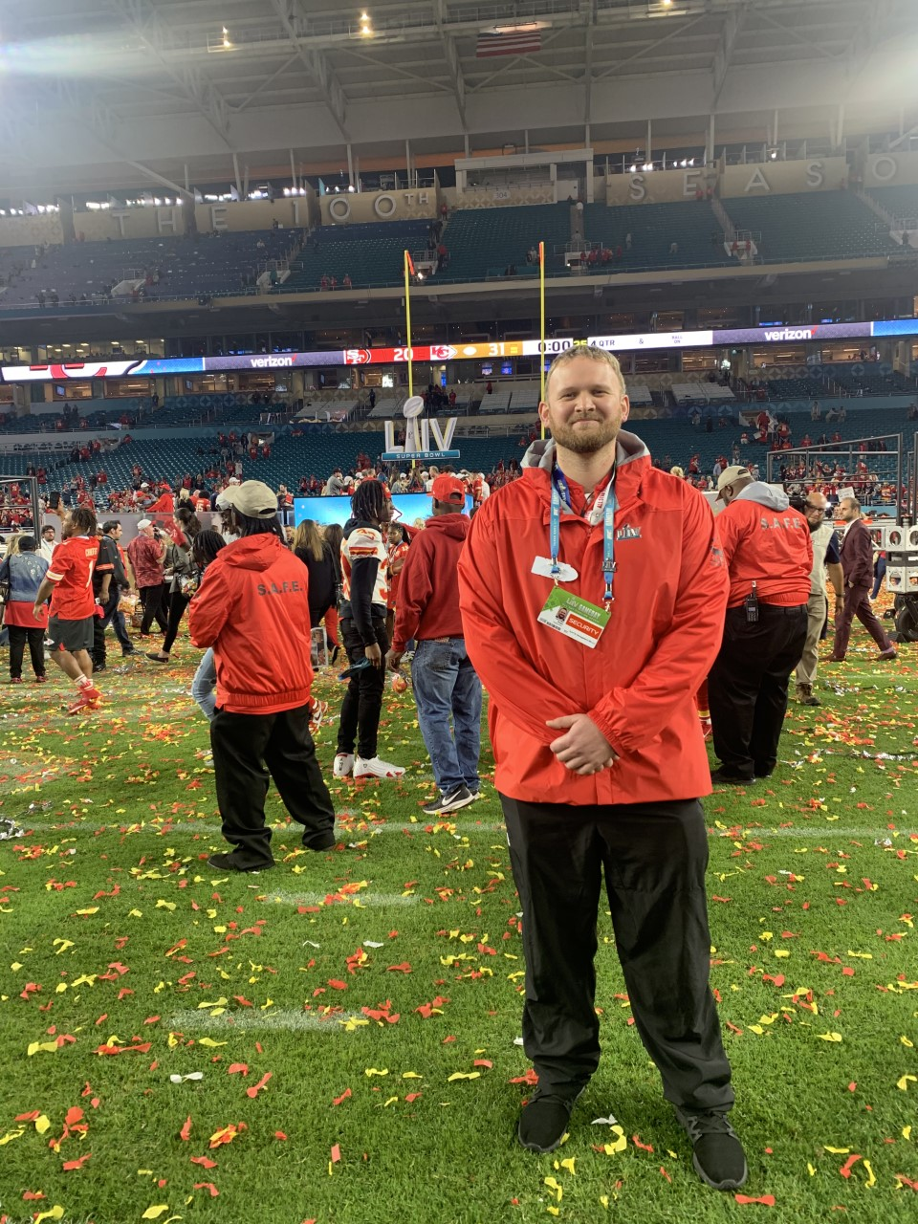
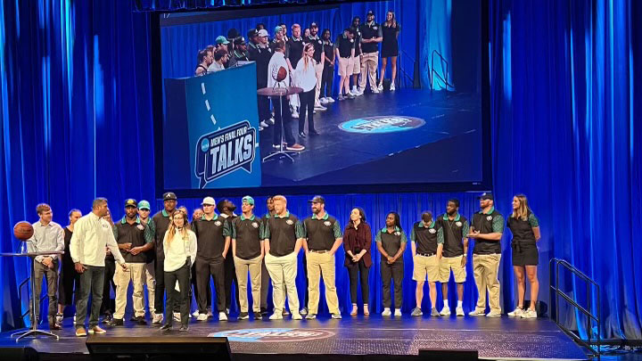
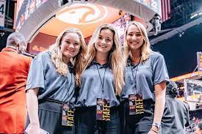
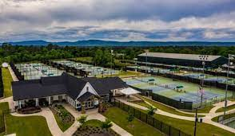
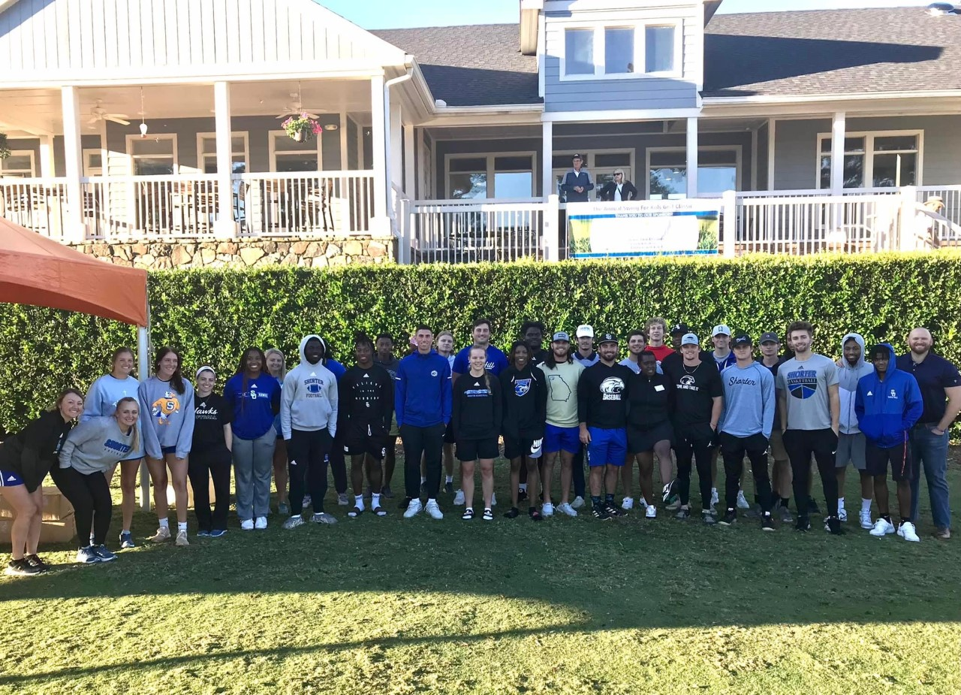
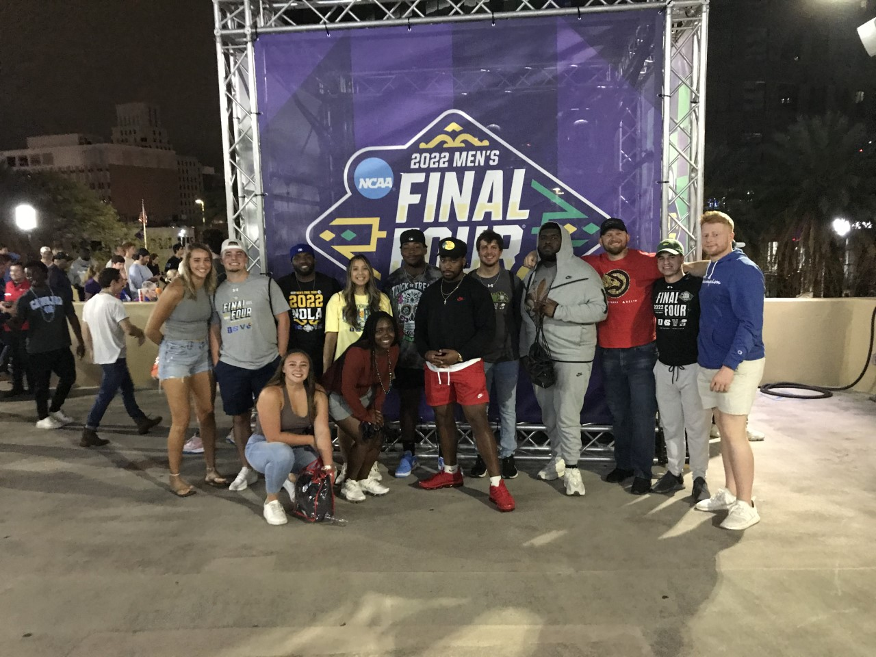
Experiential Learning Opportunities: Large- and Small-Scale Events

Slide 11
Results Observed Thus Far:
Students/Alumni
Our students are more frequently being hired for the jobs they desire.
Our graduates are being promoted and actively pursuing improved opportunities at a successful rate.
Feedback from Internship supervisors has increased and display praise for professionalism, maturity, and skillsets of interns.
Our alumni seek to serve current students when given the opportunity (our goal is to improve this even more).
More BBA graduates are seeking their MBA within our program.
Program
Voted #1 Online BBA for 2022 and 2023.
Candidate application pool quality has improved.
Growth of major has increased over the last two years (largest in the university).
Retention has increased significantly.

Slide 12
Correlation to COSMA Principles:
COSMA Principles addressed
COSMA Principle 7.6: Diversity in Sport Management: These best practices will display the opportunity students have to network and learn from a wide array of sport management industry professionals while earning invaluable experience simultaneously. Industry professionals, academics, and students are all subjected to various forms of diversity while engaging through a unified medium that exists as sport.
COSMA Principle 8.0: Educational Innovation: These best practices will display the continued adaptation and evolution of higher education and efficient and effective experiential learning tactics that benefit all stakeholders within this realm. As sport continues to evolve, we must also evolve with it for the continued benefit of our institutions, organizations, and overall student well-being.

