Slide 1
Developing International Professional Learning Communities with Global Partnerships to Connect Expertise in Teaching, Research, and Service
Dr. Suzannah Armentrout, Minnesota State University, Mankato
Mr. Martijn Kamper, HAN University of Applied Sciences
Dr. Vicki Schull, Minnesota State University, Mankato

Slide 2
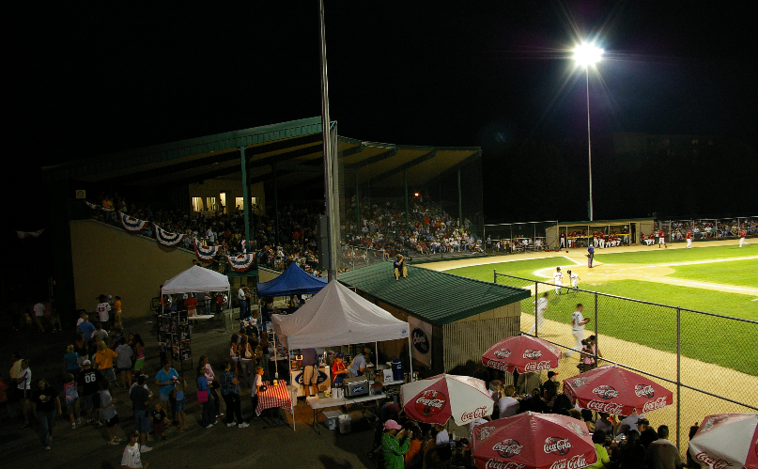
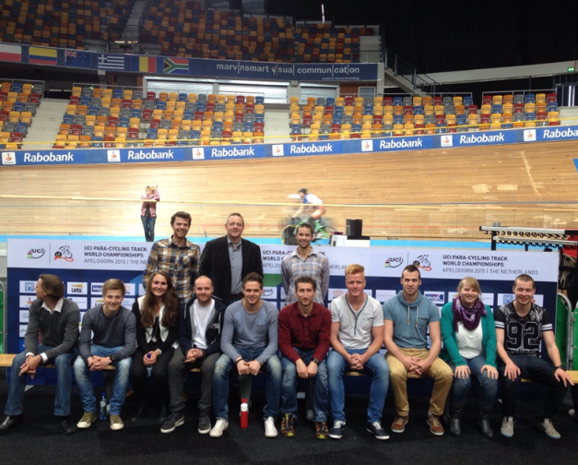
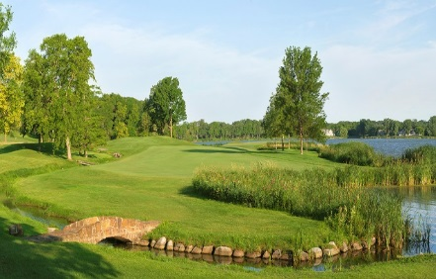
What does an iPLC Look Like?
Connecting Expertise
Learning & innovation takes place at the intersection of expertise and in the triangle of teaching, research, and service.
Education
MSU
Faculty & Students
HAN Faculty &
Students
iPLC
Research
Services
Sport Org.
Notes:
Joint development of the curriculum using the expertise from both universities, as well as the sport organization is key, resulting in a higher level of expertise for all partners
HAN and MSU students working together in a joint class
They come here one year and then we go there.

Slide 3
Why Develop an iPLC?
Provides a lever to bring both students and industry to a higher level of competency and leadership (Danylchuk, 2011)
Internationalize our teaching, research, and service opportunities
Need to further develop:
Students’ cultural awareness and immersion
Students’ networking opportunities
Students’ professional development through experiential learning opportunities
Faculty exchange of knowledge
Faculty teaching, research, and service
Program exposure and marketing within and outside of the university
University exposure and marketing (Tamburri, 2007)
Notes:
Ensure students are prepared and can effectively function in a dynamic global industry
The focus on global education and internationalization of our teaching, research, and service opportunities
Students beyond exchange opportunities only

Slide 4
International Professional Learning Community – Example
MSU Mankato / HAN UAS
Education
Theory & methodology
Coursework on chosen topic: Sport tourism, economic impact analysis, etc.
Development of service
Connecting expertise
Students Students
Han MSU Faculty Faculty
Digital, custom
Questionnaires
3 Way Partnership: MSU Mankato, HAN UAS, Sport Organization
Research & Experience
Economic impact research or spectator satisfaction survey
Experiential learning - event
Data
MSU Mankato / HAN UAS
Education / Research
Data analysis
Developing new standards or methodology
Daily
result
updates
Expert Presentations/Updates (connecting expertise)
Stakeholders/
Sponsors STAFF Ryder Cup
Faculty Students
Develop Report
SERVICES
Report analysis (possibilities)
Economic impact
Visitors / fan profile & satisfaction
Sponsor / stakeholders satisfaction
Volunteer experience
Loyalty & expectations
Social impact
Bid optimization
Sport Organization
Week 1
Week 2
Week 3

Slide 5
How Did We Do This?
Developed study abroad program over a number of years
Faculty visits to develop the study abroad programs
Faculty developed their local partnerships
Mutual interest to expand global curriculum
Conversations with sport org. to determine need/interest
Followed the path of interest in partnering
Notes:
“ironed out all the kinks” in study abroad opportunities for HAN and MSU students
Building trust
Following the path of interest in partnering - led to conversations with another sport organization (a CVB sports commission for economic impact analysis)

Slide 6
Funding
Set up a long term strategic plan that is not reliant on 1 person
Seek funding internally: Involve a lot of different representatives
Colleagues
Department Chairs
Dean’s
VP’s or Presidents
Study Abroad directors and staff
Extended Education
Director of Marketing
Community leader
Notes:
“ironed out all the kinks” in study abroad opportunities for HAN and MSU students
Building trust

Slide 7
Funding
Seek funding for reassigned time to:
Develop current partnership
Develop future partnerships
Develop joint classes with partner university
Develop and analyze economic impact analysis, market research, etc.
Organize study abroad program/travel
Notes:
“ironed out all the kinks” in study abroad opportunities for HAN and MSU students
Building trust

Slide 8
Strategies for Success
Start planning >1.5 years ahead of time
Pursue partnership with a university that is willing to partner and is complimentary to your program
Pursue partnerships with sport organizations that have a similar vision
Know university deadlines
Consistent and reliable communication is key
Schedule regular video conferences via GoToMeeting
Determine clear responsibilities and consider a contract
Pursue funding for time and resources
Notes:
Complimentary in terms of teaching (maybe they have different focus e.g. sport economics and event/facilty/marketing) or maybe the faculty have similar research interests.
The similar vision is important for the sport organization and universities as you don’t want to partner with an organization that just wants to use your students as free labor

Slide 9
Additional Considerations
Start small and build on that foundation
Student financial aid
Differences in the amount of time MSU/HAN students want to study abroad
Time of year
Moving other classes so they don’t conflict with the iPLC
Determine barriers
Use professional network
It is always a work in progress
Need to be invested and passionate about this!
Persistence is key
Notes:
Barriers: e.g. university semesters differ
Time of year: determine when your students are interested in studying abroad

