Slide 1
Filling the Gaps of Project-based Curriculum with Professional Engagement
Sports, Careers, Opportunities, Recruitment, and Employment (S.C.O.R.E.) Symposium
and
Sport Management Academic Advisory Board’s “Warrior Wake-up”
Jaedeock Lee and Edward J. Arner
East Stroudsburg University

Slide 2
Student Engagement and Networking
Presentation Objectives:
Outline professional engagement outside required project-based curriculum.
Student Learning Opportunities with Experience/Engagement
Event Assessments
Limitations of the student experience
Curriculum/program development to overcome limitation

Slide 3
Organization and Administration of Sport Operations (SMGT 445)
Course requirements:
Special Olympics Of Pennsylvania Invitational/Sectional (Fall)
National Intramural and Recreational Sports Association (NIRSA) “Rec Day” (Spring)
Notes:
Project-based learning experiences – identify the “gaps”
1. Networking soft skills is the gap

Slide 4
Opportunity to Fill in the Gap
ESU Sport Management Department offers opportunity for involvement:
Warrior Wake-up
Sports Career Opportunity Recruitment Employment
Guest Speaker Lecture Series
Program and Course Partnership
Notes:
Program and course Partnerships: Sport Marketing, O+A Course Requirements, Sport Facility Requirements

Slide 5
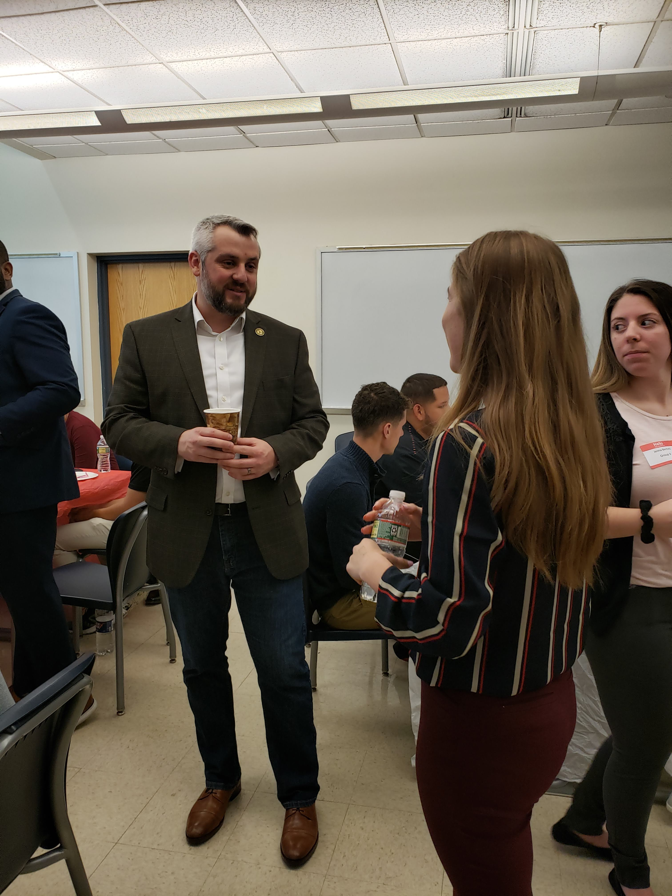
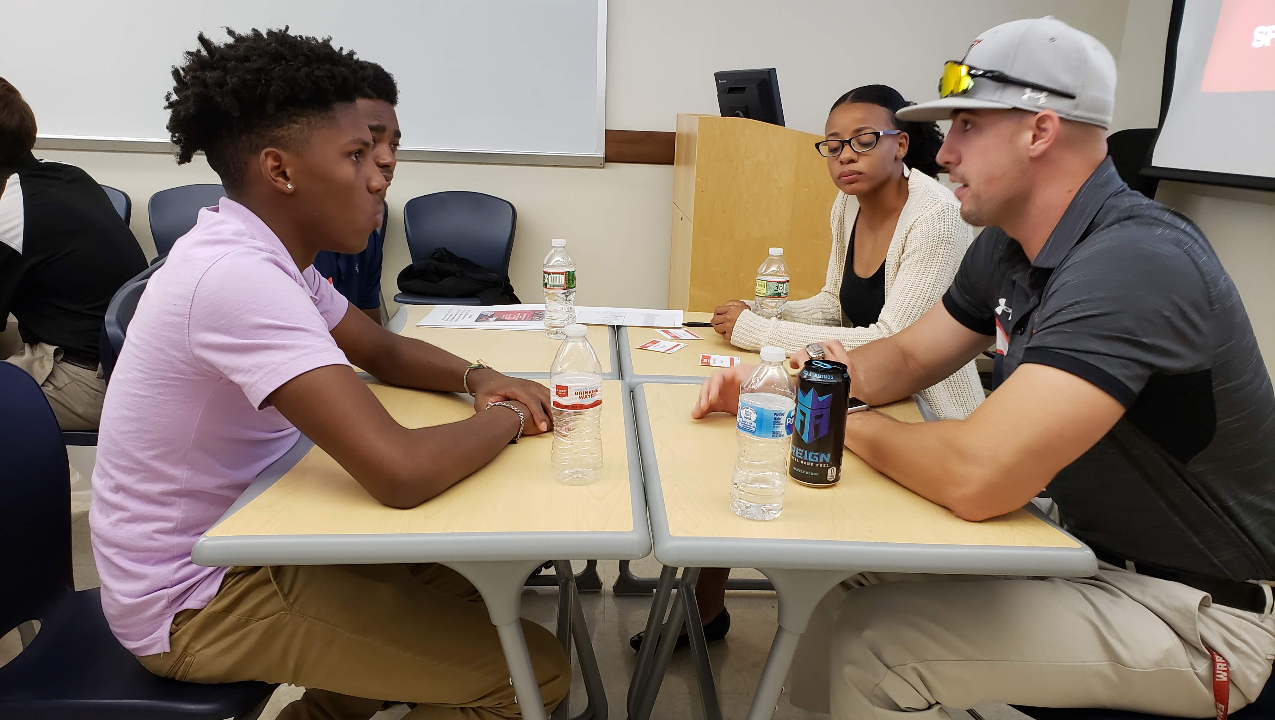
ESU Warrior Wake-Up
Exposure to Social Networking
Creating that DISTINCTION
Soft Skill Development
Hard Skill Application
Notes:
Brandon Lawernce is Director of Group Ticket Sales for MSG
Homecoming – early morning

Slide 6
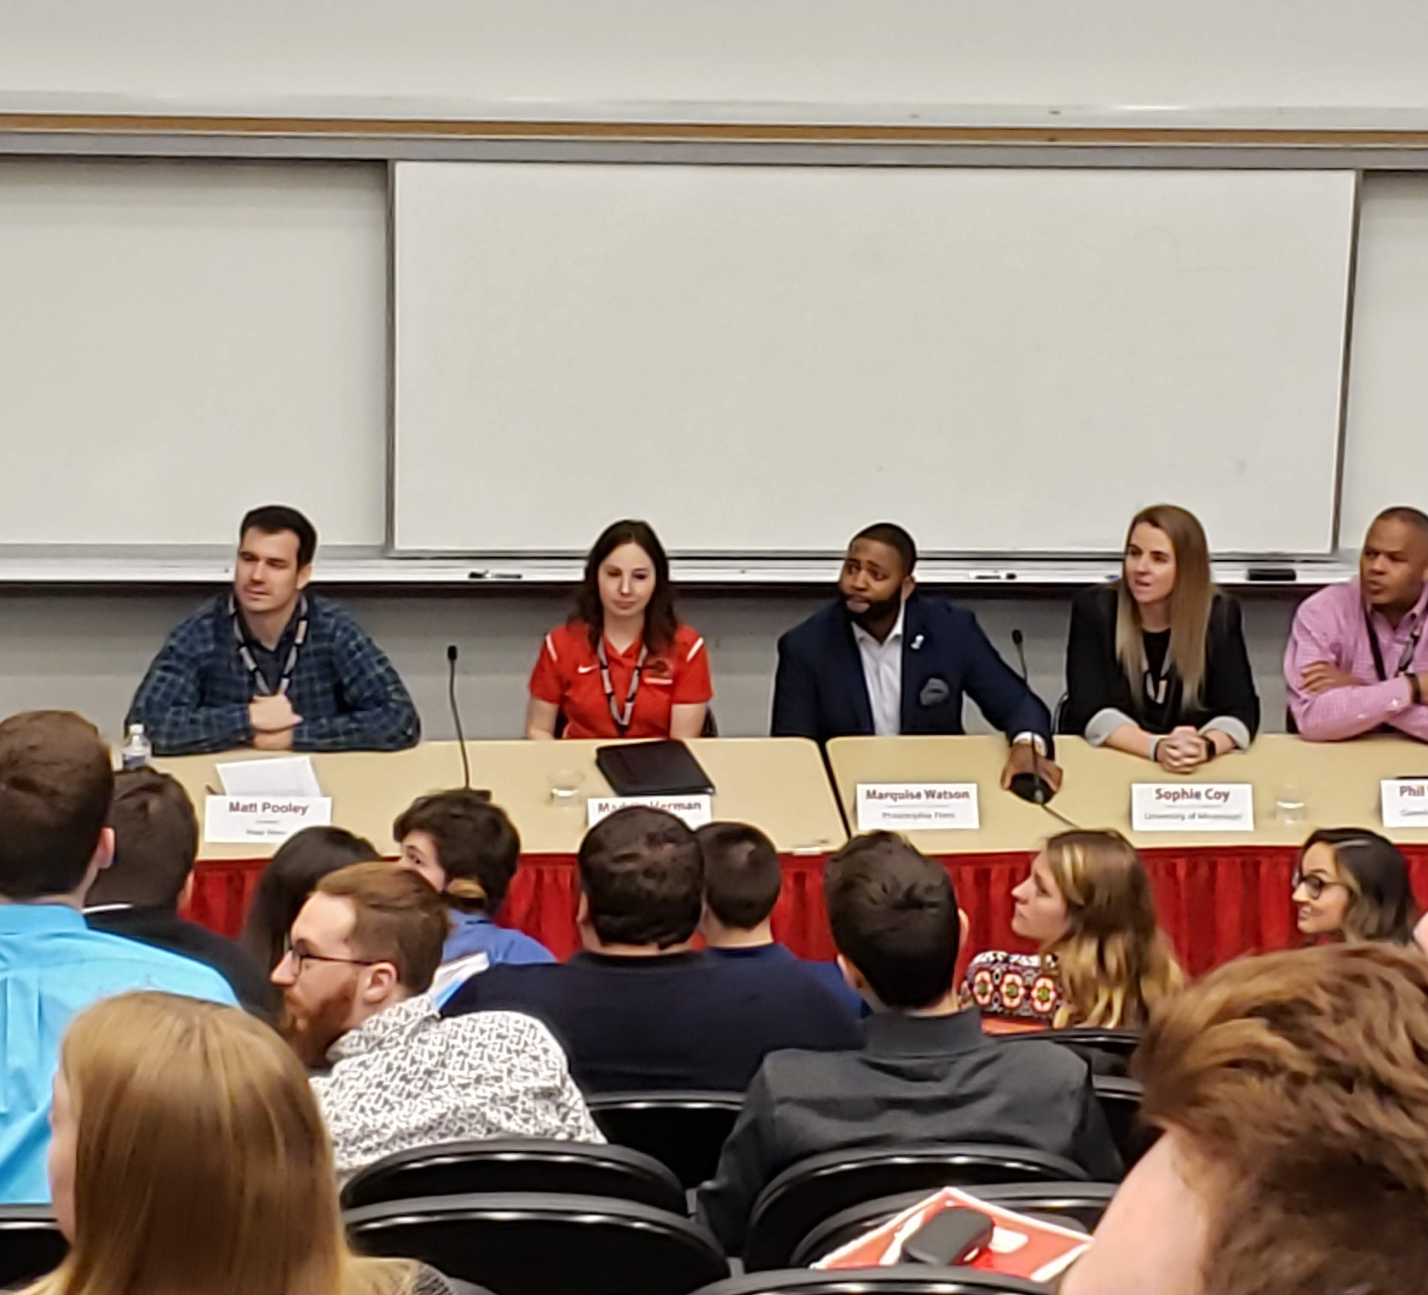
S.C.O.R.E. Symposium
Exposure to Industry Professional
Focused on Student Interests
Soft Skill Development
Hard Skill Application

Slide 7
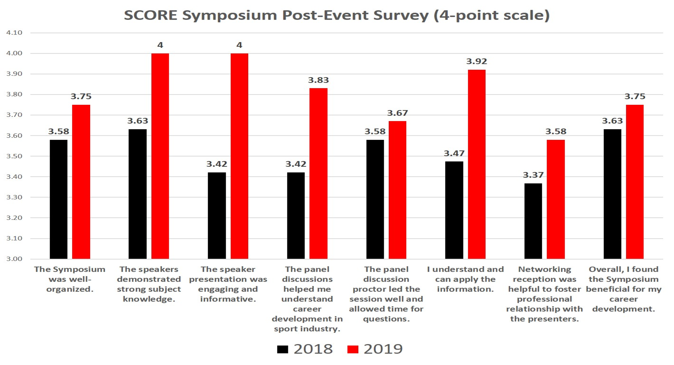
Notes:
Program and course Partnerships: Sport Marketing, O+A Course Requirements, Sport Facility Requirements

Slide 8
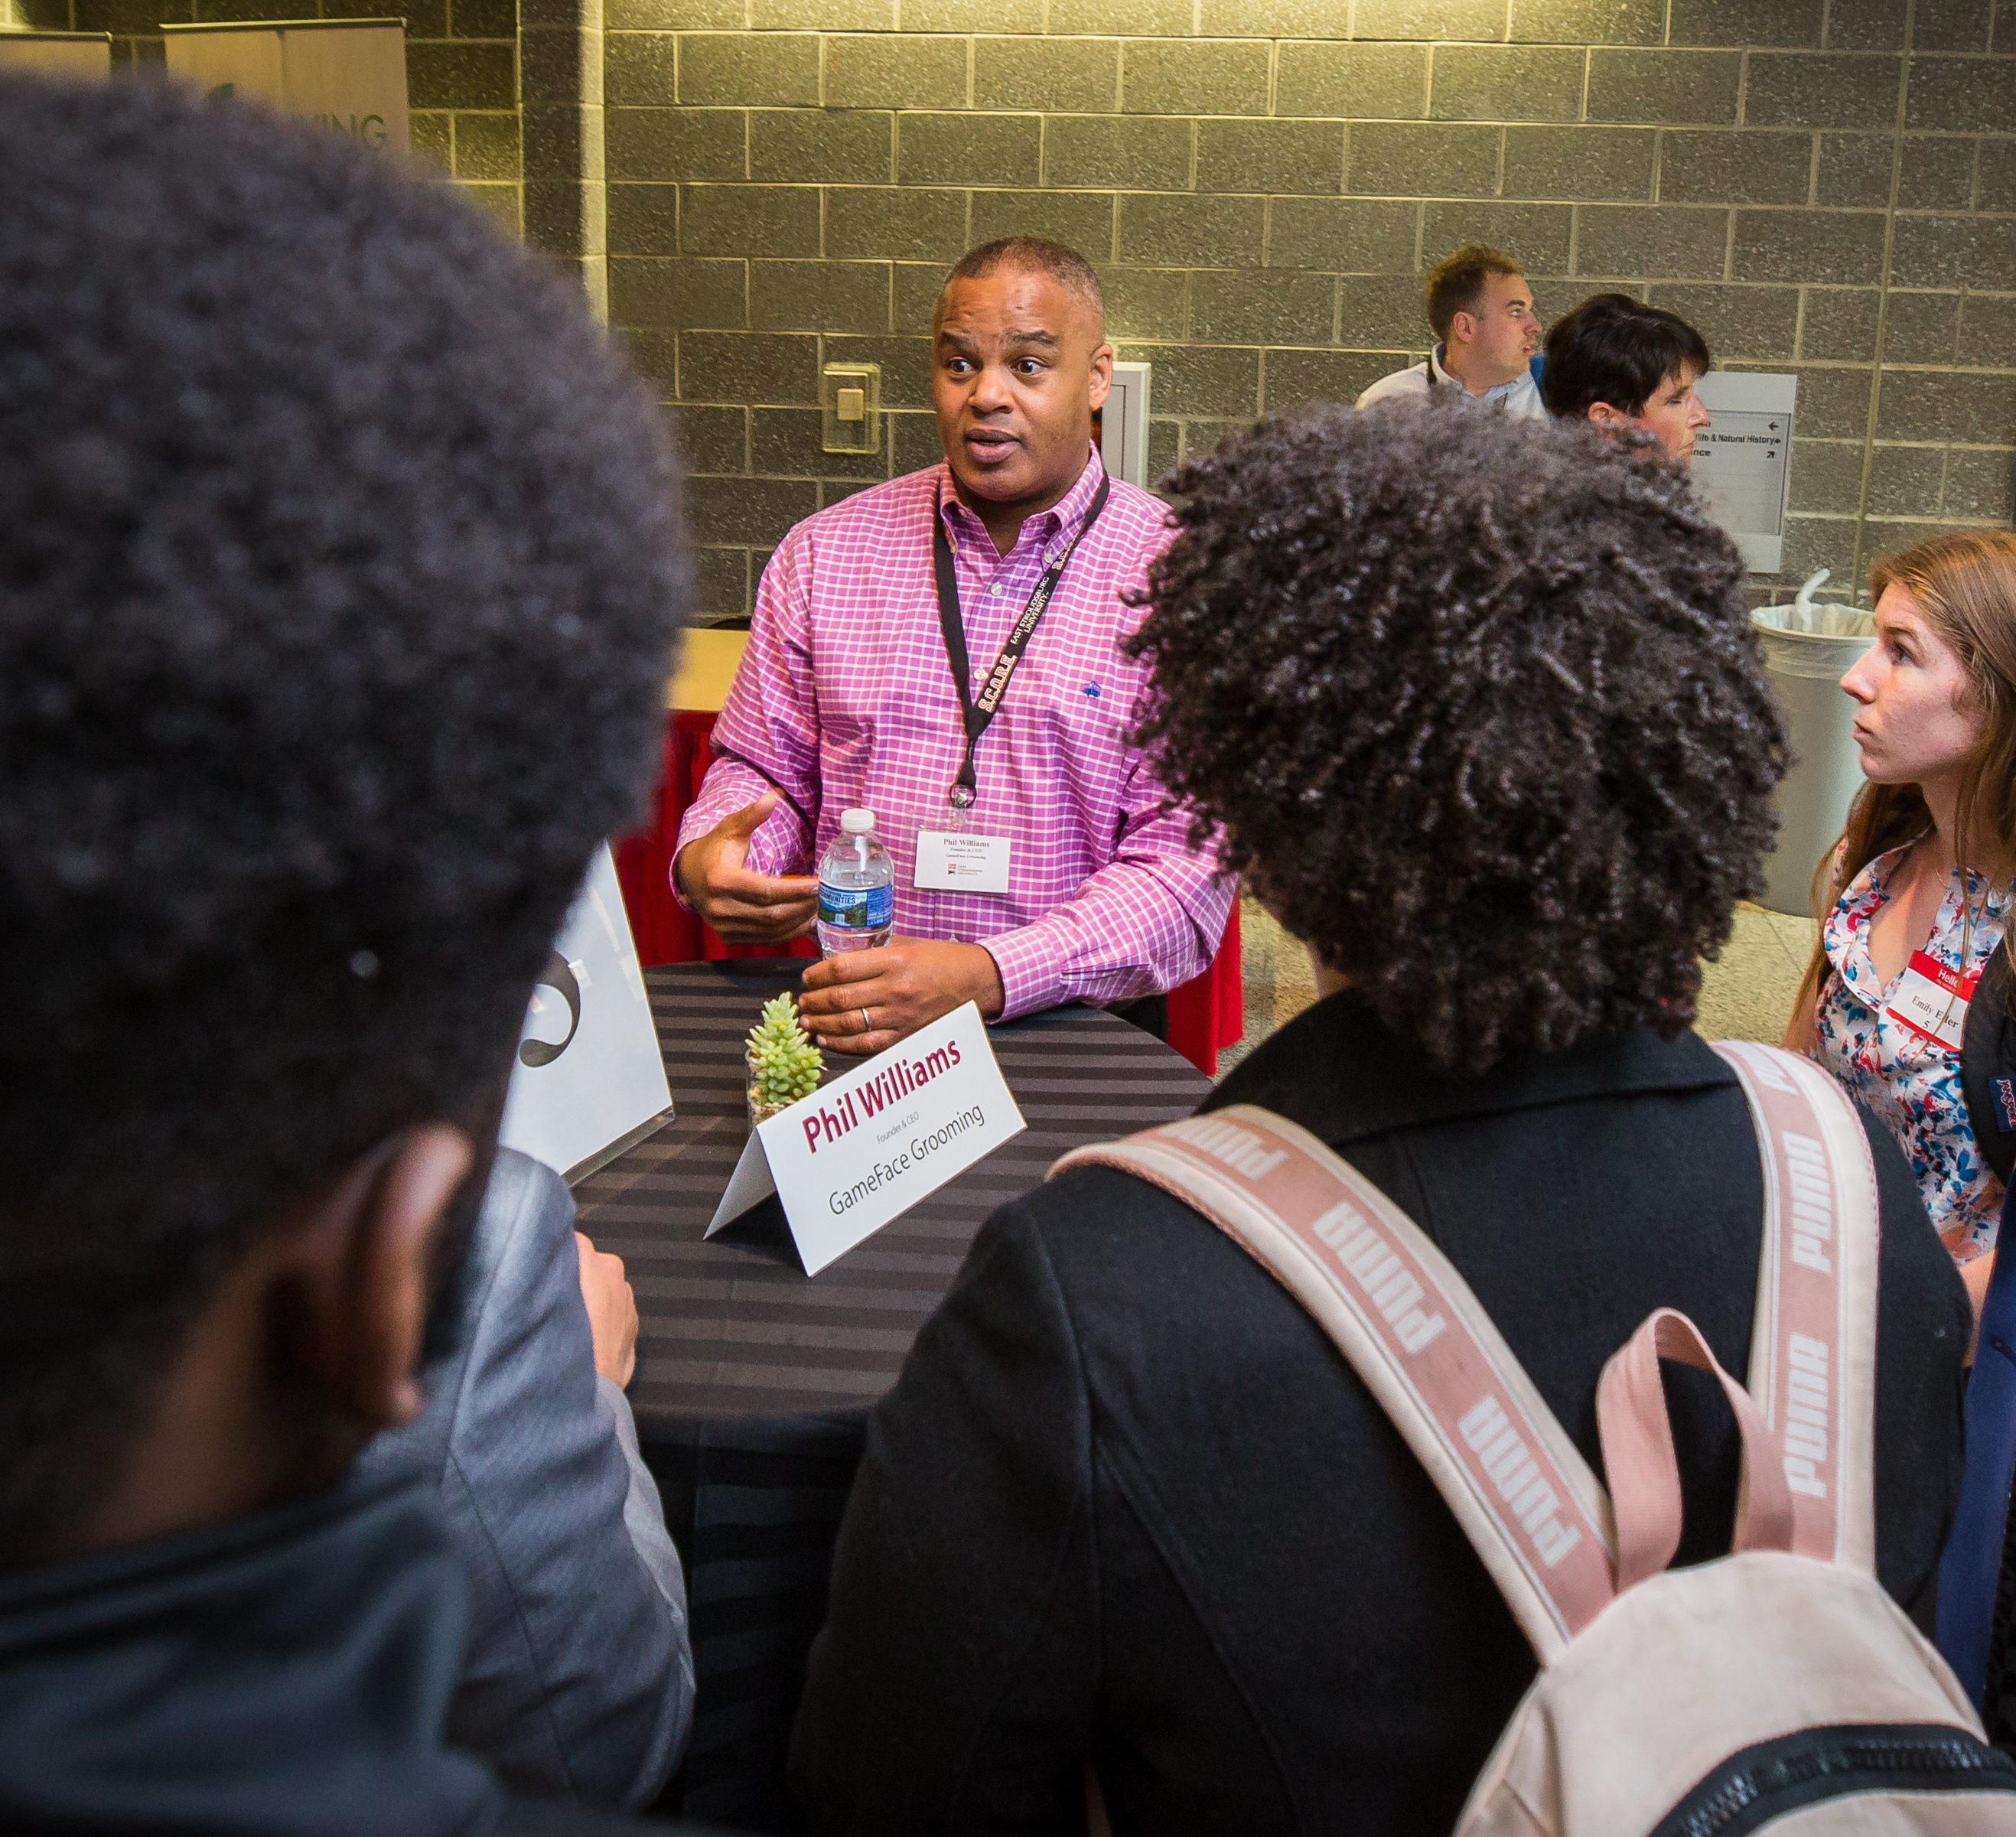
Event Assessment (cont.)
Event Feedback from Sport Organizations and Professional
Phil Williams
Marquise Watson
Brandon Lawrence

Slide 9
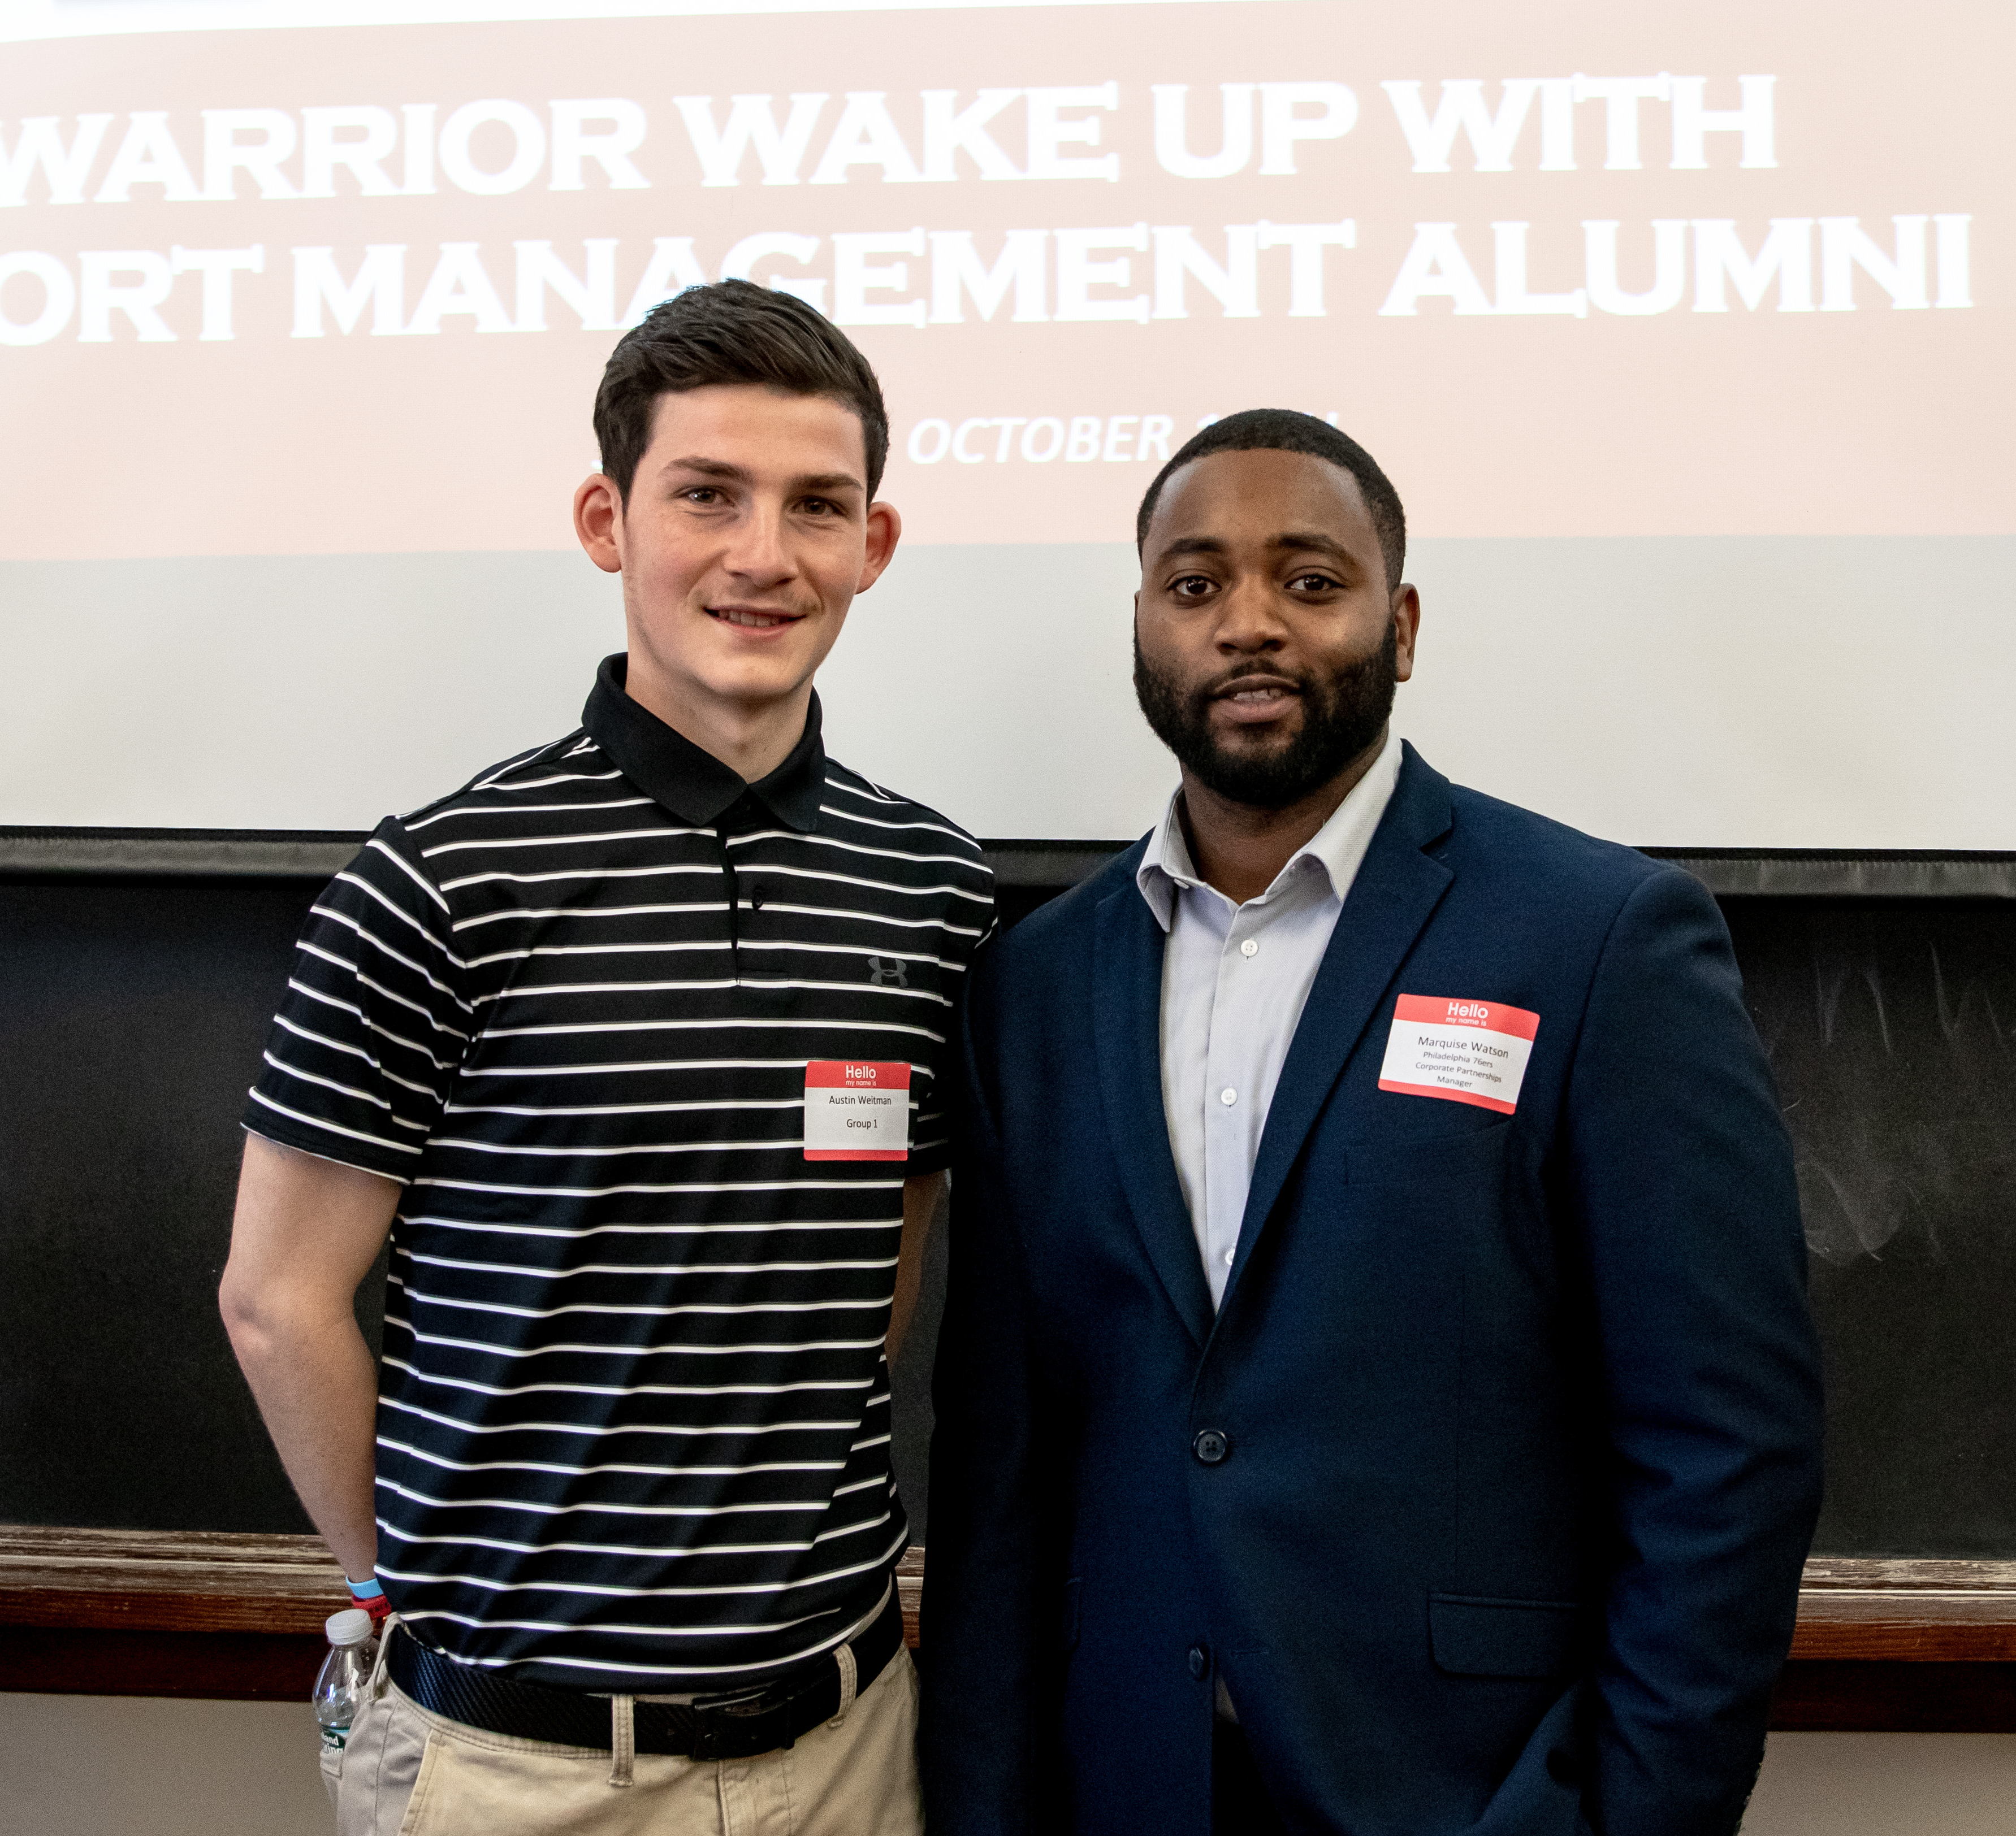
Event Assessment (cont.)
Event Feedback from Student
“Interviews can be conducted in various ways so it is important to do research and intently pay attention during interview processes.”
“To get outside my comfort zone when applying for jobs.”
“One of the things I learned was about mobility in the sport industry. People move quite often from role to role, and there are lots of opportunities for internal advancement.”

Slide 10
ESU Sport Management Event Assessment
Student Limitations with Experience
Student value/investment
Work outside classroom
Resume or Professional Portfolio
Curriculum/Program Development
Early opportunity for involvement within the program
Event Flexibility
Notes:
Student Limitations with Experience
Student value/investment- underclassmen involvement
Work outside classroom- Completing work only required for class
Resume or Professional Portfolio- more attention needed …SMGT Club is not enough
Curriculum/Program Development
Early opportunity for involvement within the program
Event Flexibility include students in the committee

Slide 11
ESU Sport Management Event Assessment
Sport Management (for other Majors)
Athletic Coaching
Sport & Exercise Psychology
Business and Management
Communication Studies
Digital Media & Technology
Notes:
Student Limitations with Experience
Student value/investment- underclassmen involvement
Work outside classroom- Completing work only required for class
Resume or Professional Portfolio- more attention needed …SMGT Club is not enough
Curriculum/Program Development
Early opportunity for involvement within the program
Event Flexibility include students in the committee

Slide 12
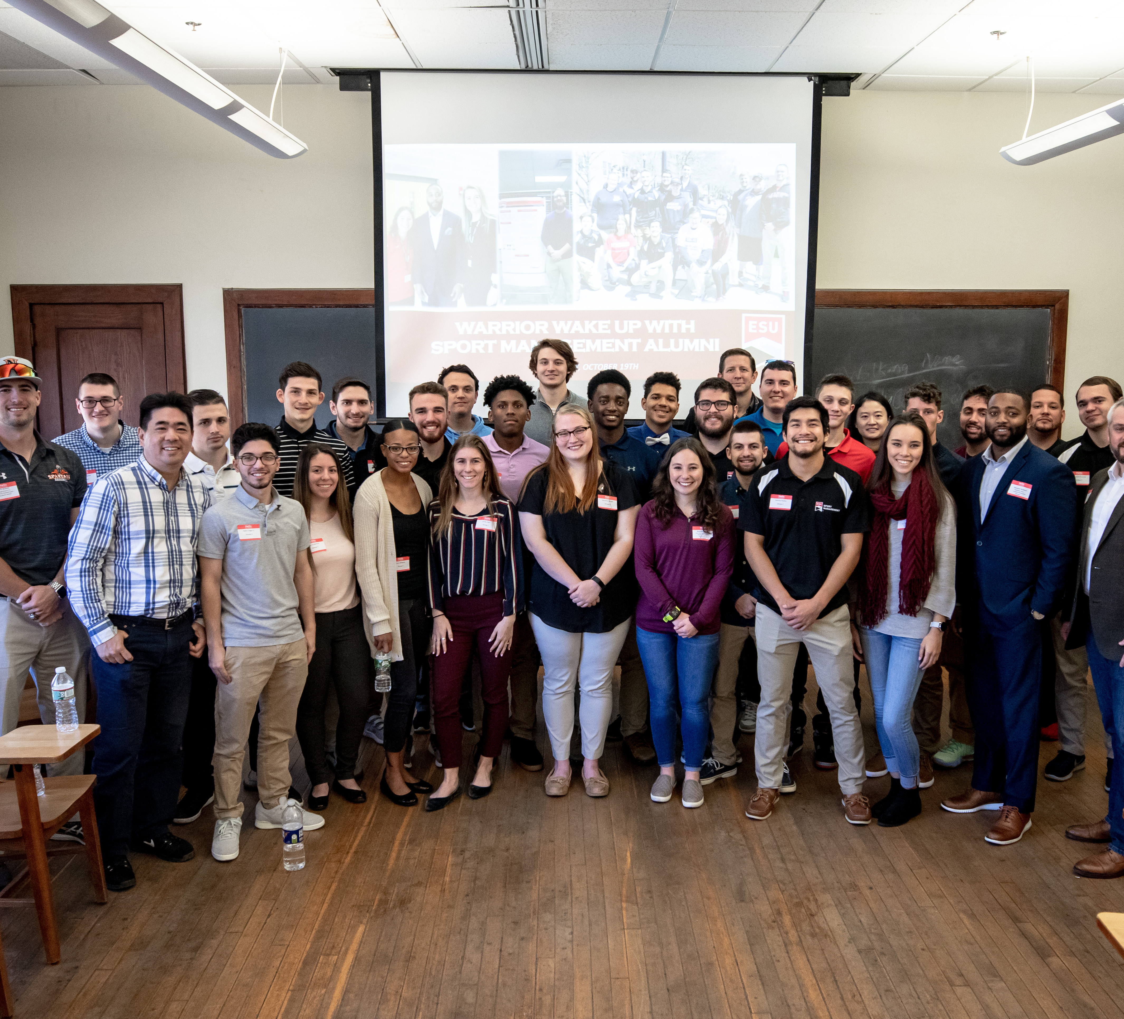
Open Forum
Questions, comments, or concerns?

