Slide 1



Appreciative Inquiry:
An Approach to
Human System Change in the Management of Sport
Darlene A Kluka, D Phil, Ph D, Research Associate
University of Pretoria, RSA
Email: eyesport@aol.com
Notes:
I had the opportunity to determine the types of theories of change that I would add to the course, Governance of Sport while I was at Barry University in the Master of Science program. After having taken a course from Case Western Reserve’s School of Organizational Management, I decided to introduce a different way of change management that was an approach to human system change. Its result was the introduction of the construct of appreciative inquiry that was an approach to human system change in the management of sport.

Slide 2
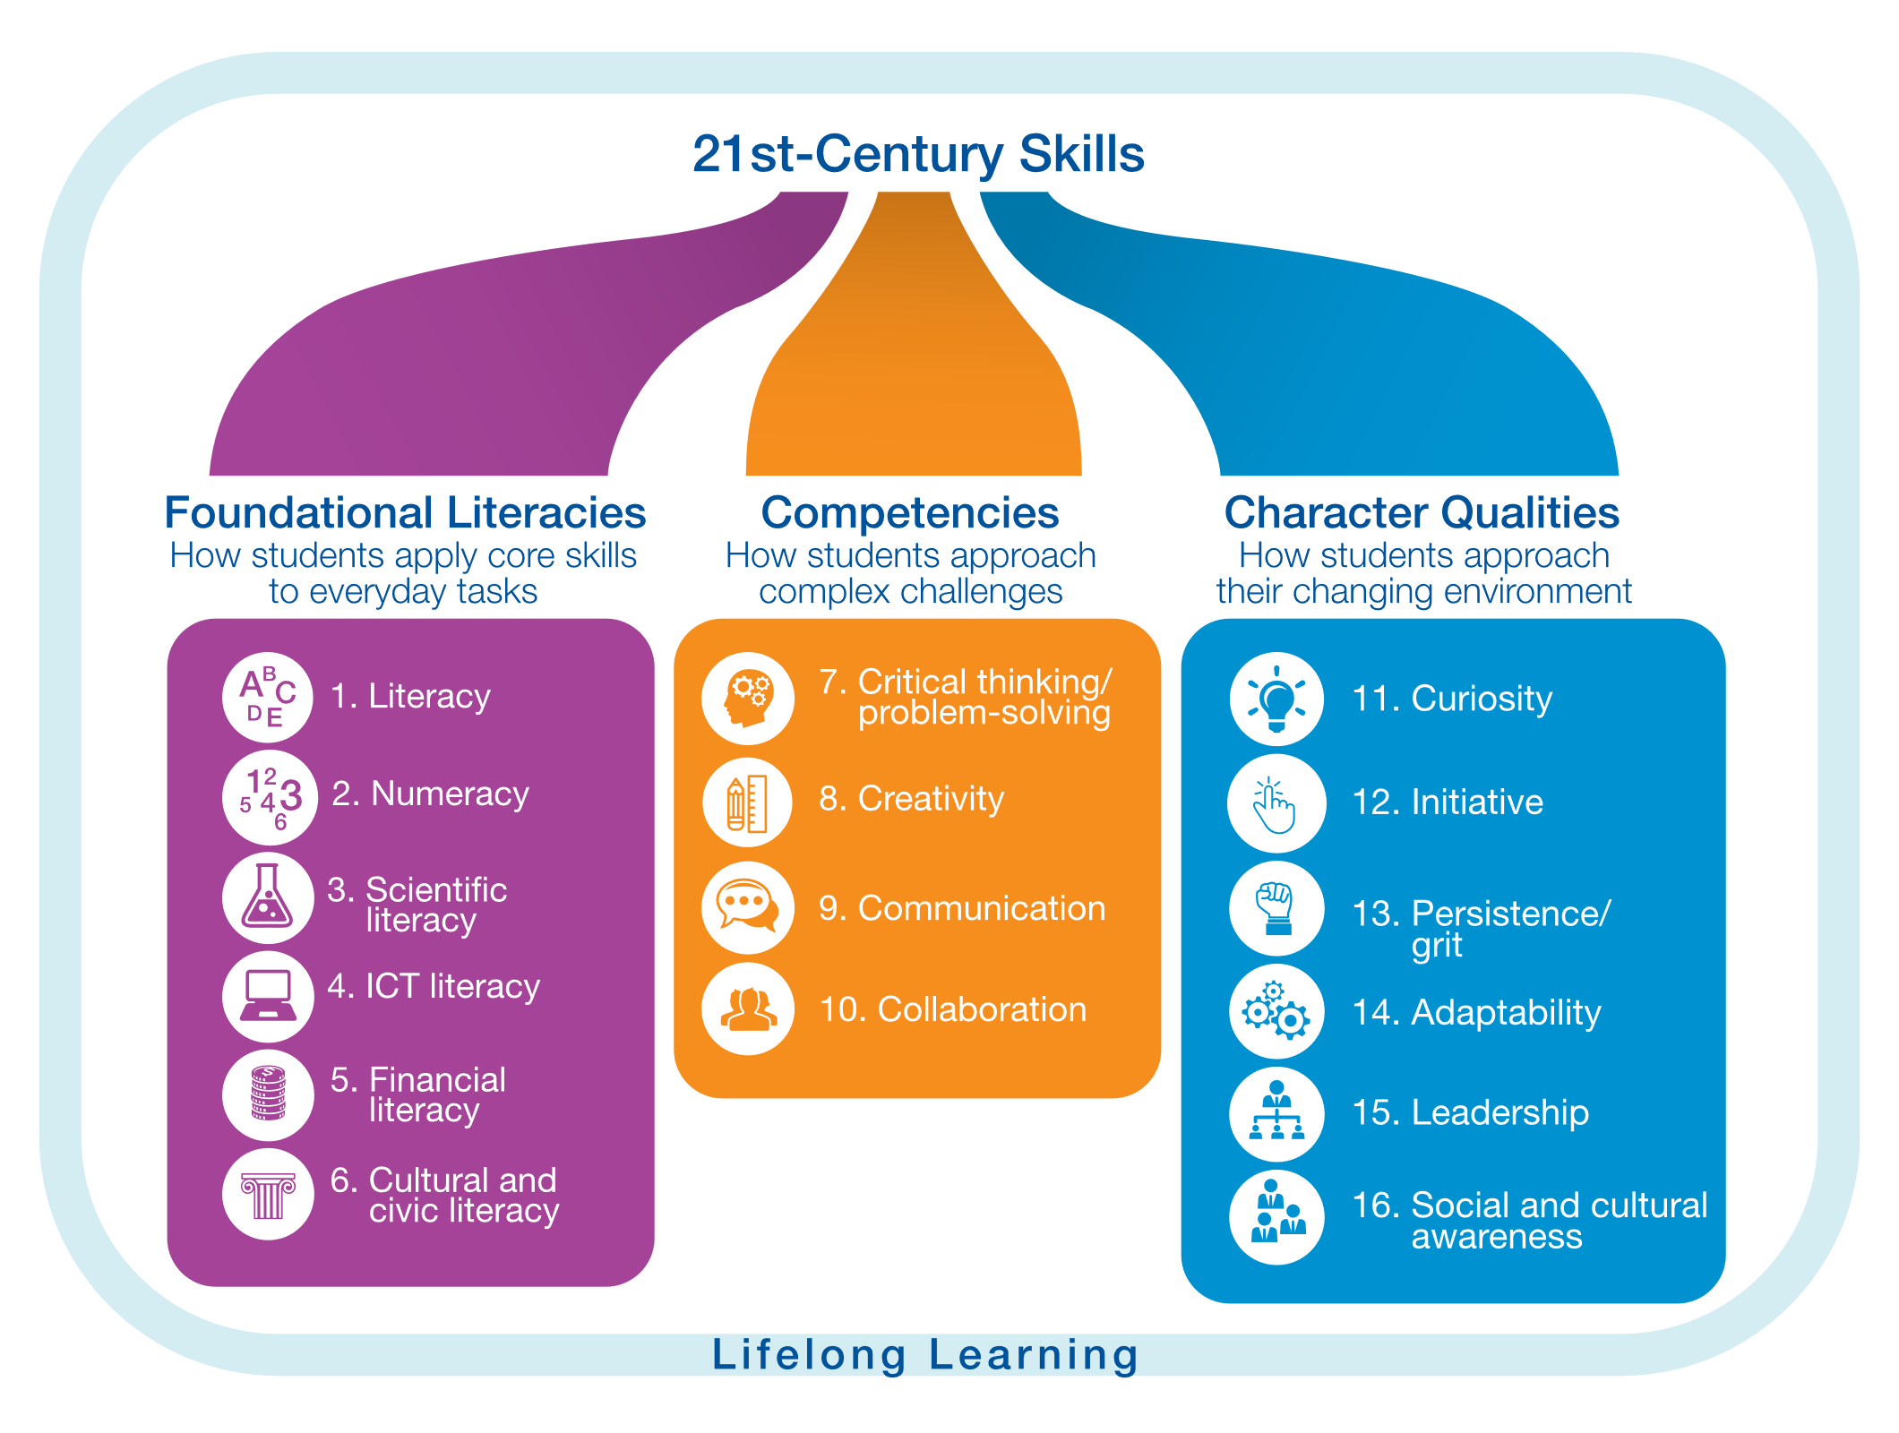
World Economic Forum - https://widgets.weforum.org/nve-2015/chapter2.html
17. Resilience
Notes:
According to the World Economic Forum (2015), 16 skills are necessary for 21st century success. They are categorized into three groups: foundational literacies, competencies, and character qualities. Are your students prepared in these areas for 21st century functioning? I would also like to add the character quality of resilience. Resilience involves a process of adapting well in the face of adversity, trauma, tragedy, threats, or significant sources of stress—such as family and relationship problems, serious health problems, or workplace and financial stressors.
If there are gaps in foundational literacies and competencies, there can be skills gaps that are significant macro-level issues that impede learning. These factors include poverty, conflict, poor health and gender discrimination. Progress in addressing the 21st-century skills gap cannot be made without tackling these basic elements.

Slide 3
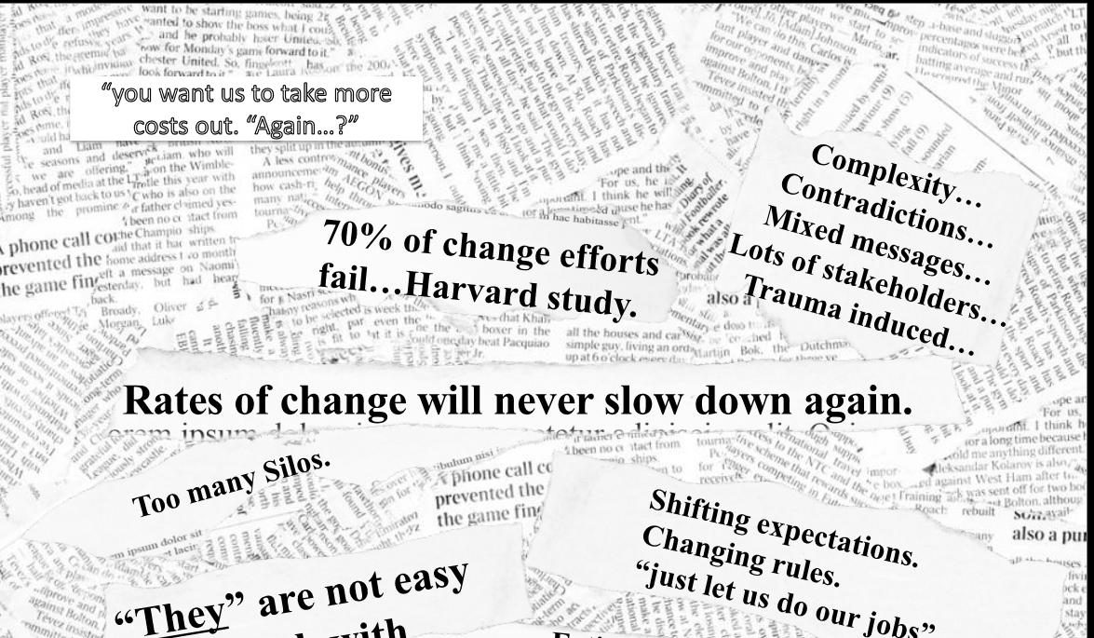
Notes:
During this time of great uncertainty relative to the present and the future, change is quite the buzz word for sport organizations and their leadership. Looking at possibilities for the future,
What percent of large-scale change efforts succeed?
20-30 %

Slide 4
What percent of large-scale change efforts succeed?
Less than 20 %?
20 – 30 %?
31 – 50 %?
51 – 75 %?
More than 75 %?

Slide 5
What is Appreciative Inquiry?
- A collaborative and rigorous search to identify and understand an organization’s strengths to:
  Imagine our highest hopes and greatest possibilities, to stimulate thinking and aspirations
  Co-construction of the ideal future, and
  Launch self-directed change and innovation

Slide 6

Principles of Appreciative Inquiry
Seeks to locate, understand, and illuminate life-giving forces of human existence.
Has a new platform to imagine possibilities for a preferred future.
New possibilities become opportunities for constructing future scenarios and launching self-managed change initiatives.
Organizations are centers of connections:
  Relationships, partnerships, alliances, values of ideas, knowledge, and actions
  Cooperative search for the best in people, their organizations, and the world around them

Slide 7
Appreciative Inquiry is:
Strengths-based
Collaborative – interactive space
Inclusive – whole system involved at once
An artful search – search for what gives life to any situation
Generative – connections for productivity, well being, learning, cooperative capacity, resilience
Search for strengths
Imagine highest hopes and possibilities
Construction of ideal future
Launch self-directed change and innovation

Slide 8
Applications of AI are based upon positive psychology, positive organization scholarship, and neuroscience:
Constructionist Principle: As we talk, so we make.
Poetic Principle: As we choose topics of inquiry, so we open new horizons of action.
Simultaneity Principle: As we ask positive questions, so we transform.
Anticipatory Principle: As we imagine, so we create.
Positive Principle – As we express hope, joy, and caring, so we create new relations.
Narrative Principle: Stories weave a connectedness that bridges the past with the future.
Notes:
Constructionist Principle: Words create our world. Potent tools that allow culture to move and coordinate ongoing relations with one another.
Poetic Principle: Organizations are open-ended, evolving networks of possibilities open to an endless variety of interpretive perspectives. We can study anything in any organization, at any time. We can choose to notice dynamics of stress, conflict, competition, OR study the dynamics of hope, cooperation, competence, or joy.
In AI, the change agent is more like a poet crafting words than an archeologist digging for hidden continents. Choosing positive topics will lead to transformation.
Principle of Simultaneity: As we ask positive questions, so we transform. Inquiry is intervention. There is no such thing as a neutral question. Every question leads into a social topic and begins a conversation that creates, maintains, or transforms a way of being and doing.
Anticipatory Principle: As we imagine, so we create. If you want to change a human system, change the future. Transform – project a future image. Deep and lasting change comes from changing or anticipatory images of the future. Positive images can change us at the cellular level (healing, recovery, resilience).
Positive Principle – As we express hope, joy, and caring, so we create new relations. Organizations are affirmative and responsive to positive images and positive language. The more positive questions, the more opportunities to create and sustain positive discourse.
Narrative Principle: The power of stories can be a catalyst for change.

Slide 9
Deficit Theory of Change
Most institutions of higher education, sport programs, professional sport teams, and Olympic family members appear to function on an unwritten rule:
Let’s fix what is wrong and let the strengths take care of themselves.
Unintended consequences:
Fragmentation
Exhaustion that spirals in deficit language and voice (40 K articles on anxiety; 25 K articles on medical and dysfunction)
Breakdown in relations/closed door meetings/decrease in public space/cycle of despair
Increased resistance to the next announcement
Burning platforms lose their power
SWOT shortcut – group wants to move to weaknesses or threats first – learned tendency to fix these first

Slide 10
Peter Drucker – The New Society (2nd ed., 2017; London: Routledge)
Father of Modern Management Theory
“The task of leadership is to create an alignment of strengths…making a system’s weaknesses irrelevant.”
  Could it be that leading for the future is all about strengths rather than overcoming weaknesses?

Slide 11
Deficit Management Appreciative Inquiry
Identify problem | Appreciate the Best of What is
Conduct root cause analysis | Imagine What Might Be
Brainstorm solutions and analyze | Design What Should Be
Develop treatment – action plans or interventions | Create What Will Be
Problem Metaphor – Organizations are machines
Problems to be solved…
Mystery Metaphor –
Living systems = webs of relations with infinite strengths

Slide 12
How to shift away from deficit change
To change something, start by changing the way you converse about it.
Human systems move in the direction of what we most frequently talk about.
Shift to curiosity, and value when things went right.
TIP:
  The Appreciative Leader often shifts the conversation with intentional questions that place curiosity and value on then things are going right: Sometimes when you are in a discussion about something that has gone wrong, ask:

Slide 13
When is the last time this went correctly or great,
and what enabled that to happen?
Compassion – the experience of benevolence or openness to others; caring for others who might be in pain; or joy in the search for growth.
Mindfulness – being awake and aware
Maya Angelou – You won’t be remembered for what you said or did, but how you made them feel….

Slide 14
A special time in the field of change management: Re-thinking human organization and change applied to sport management
Insights from BIG CHANGE
  Anticipatory images – collective picture of the future
  Power of engagement – simple face-to-face human conversation
THE STRENGTHS REVOLUTION and positive change research
  What good are positive emotions?
  Changing conditions of success?
WHOLE SYSTEM excellence – agility, speed, value innovation, execution, and follow through – a question of scale: Not bottom up and Not top down

Slide 15
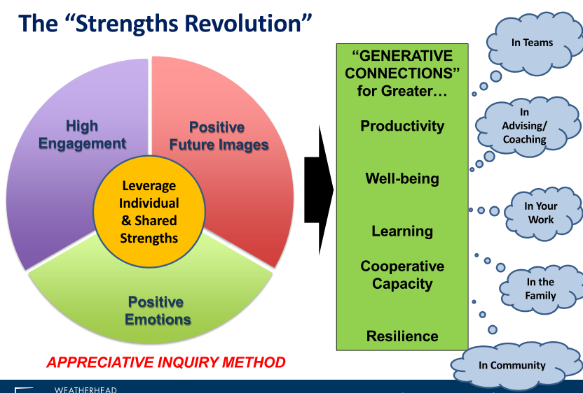
R. Fry, 2020. Case Western Reserve, Weatherhead School of Management, Department of Organizational Behavior.

Slide 16
What best predicts high engagement?
How often do I get to use my strengths at work?
                Marcus Buckingham
TIP:
Appreciative leaders continually use intentional questions to explore and uncover what it is that already helps us “be at our best.”

Slide 17
High Engagement
Compared with disengaged employees, highly empowered and engaged professionals are:
- 480 % more committed to helping their organization succeed;
- 250 % more likely to recommend improvements;
- 370 % more likely to recommend their organization as an employer; and
- 30 % less likely to be absent from work.
                (Temkin Group, Employee Engagement Benchmark Study, 2012)

Slide 18
To appreciate (verb)
To value –
  To recognize the best in people and the world around us;
  To affirm past and present strengths, successes, and potentials;
  To perceive those things that give life (health, vitality, and excellence) to living systems
To increase in value
  Valuing, prizing, esteeming, and honoring

Slide 19
To inquire (verb)
To explore and discover
To ask questions
To be open to seeing new potentials and possibilities
  To discover, to search, to study, and to systematically explore
  INQUIRY IS THE ENGINE OF CHANGE…

Slide 20
To be an appreciative leader:
You need to feel that there is truly something to be valued in the situation you face
You need to honestly believe that there is more to learn in the attendance to the situation
Go in the direction of what and how we want to go.
EXAMPLE (Intentionally positive statement)
  Please let me know how you are doing…
  Please let me know how well you are doing…

Slide 21
A highlight moment in your sport leadership career…
Recall a time you collaborated with others to unite under a common purpose to create a better future by achieving a positive impact or improvement that sustained change.
  Share this story with another person by revealing the most memorable parts, including challenges, innovations, and insights.
  Reflect together on the root causes of success. Include things about YOU in the story; things about another or OTHERS in the story; things about surrounding conditions, organization systems, norms, leadership, etc.

Slide 22
Managing continuity
When is it that the people in your organization or unit are most passionate, engaged, effective – functioning at their highest best?
Name three things that currently give life to high engagement moments (overall climate) in your organization or unit.
What are things you believe we should keep and preserve, even as we change and transform???

Slide 23
Images of the ideal future
What is the future you would like to help create?
You wake up…it is now two years later…to go to work. Everything is as you always wished it could be…everyone is energized and engaged; everyone is succeeding in their work; you are being sought out to exercise your strengths to bring out the best in others. What do you see that is new, different, changed, better?
Complete this sentence:
Two years from now, I am most proud of my organization’s impact and the way we are viewed because….

Slide 24
Summary of opening:
High point leadership moment
Continuity question
Images of two years from now
TIP:
Listen for strengths, aspirations, opportunities, and results
Find the gold in other’s stories

Slide 25
What did you notice while you were having your conversations?
Connection Energy
Smiles Happiness
Active listening Pride
Hope Excitement
Enthusiasm Confidence
Empowerment Interest

Slide 26
We live in worlds our questions create.
Encyclopedia of Positive Questions
The Art of Questioning
The Five Most Important Questions
A More Beautiful Question
TIP:
At your next meeting, start by asking everyone to share one quick story about the best thing that has happened to them since you last met. Watch what happens☺.

Slide 27
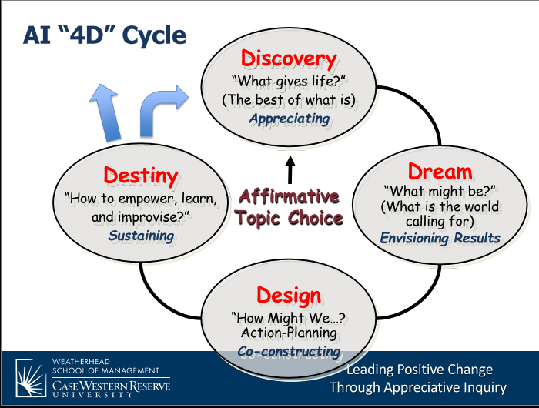
(R. Fry, 2020)
Notes:
Discovery phase – to uncover, articulate, and illuminate factor that give life to when humans have been at their best in relation to an issue. Share best past stories that contribute about how the situation could be better.
Value stories first – strengths or success factors that connect across the most stakeholder stories.
Dream phase – generate new possibilities for the future that capture heightened aspirations and positively affect generated during discovery. People imagine bolder possibilities because of an enhanced sense of the capabilities of the total collective of participants based upon common strengths and success factors in the initial stories that were shared.
Design phase – translates future images into intentional action. By using mind mapping or open space, ideas for change from dreaming can be depicted to determine a subset that energizes participants and around which new change teams can form. Form teams by each person going to an idea they most want to happen. Now craft an aspiration statement, brainstorm, prototype action plan, process map, role and decision chart, etc. to agree on a specific action path forwarded.
Destiny – create a preferred future through action and innovation. Open-ended quest for continual learning.

