Slide 1
Sustainable Cities: Incorporating the UN 17 Sustainable Development Goals Into Your Next Sport Facility Planning Project
Craig Morehead
Department of Kinesiology, Recreation, and Sport
Indiana State University

Slide 2
Common Professional Component
Functions of Sport Management
Sport Operations, Event and Facilities Management
Who has a facility master plan project in their undergrad course?
Is it for a generic, fictitious entity?
Do you discuss sustainability in this course?
Do you go beyond recycling, renewables, and LEED Certification?

Slide 3
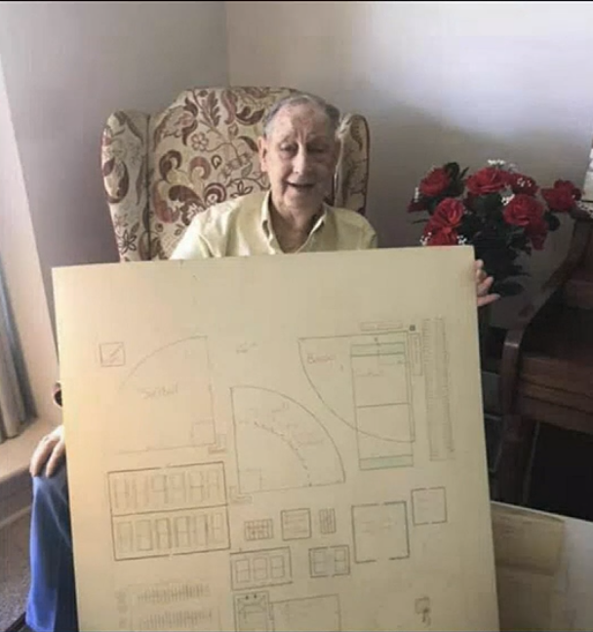
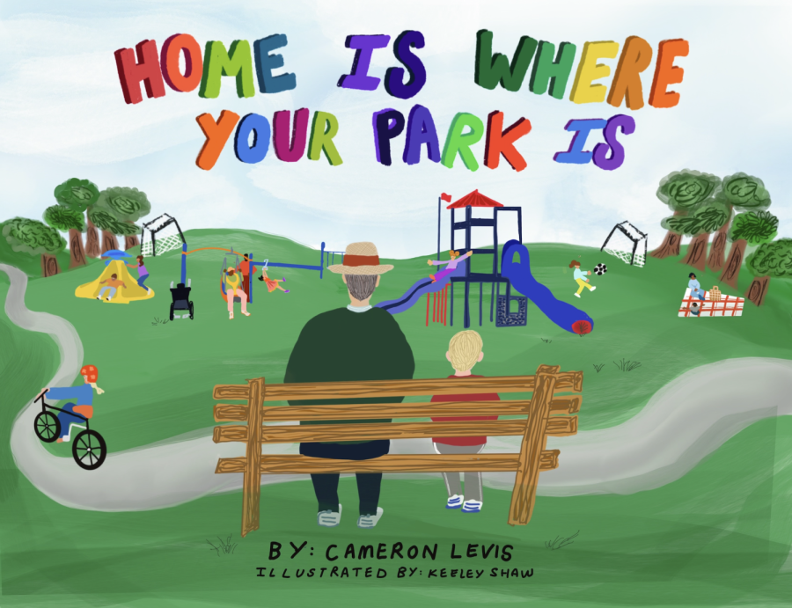
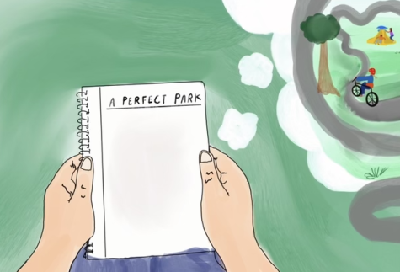
In memory of Dr. Alton Little

Slide 4
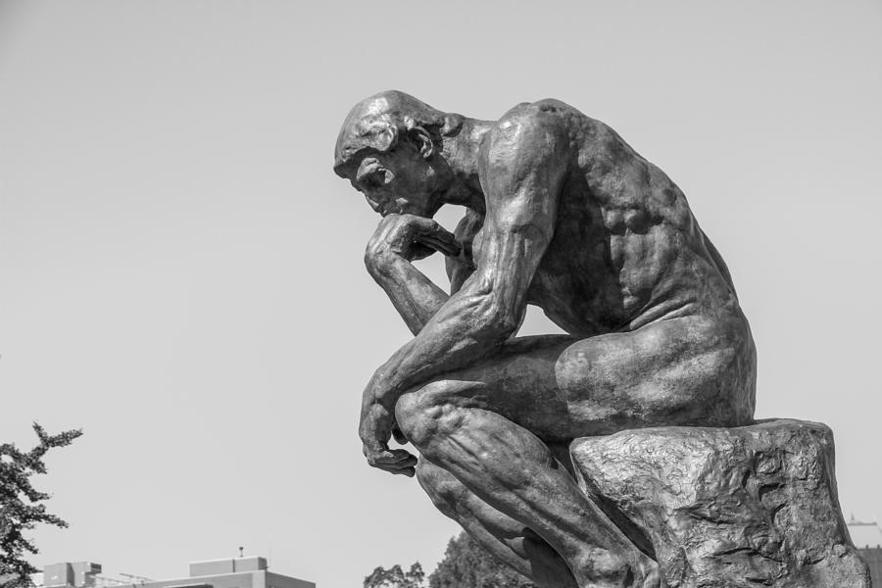

Slide 5
Sustainable Cities
EPIC Model – Educational Partnerships for Innovation in Community
Communities lack resources (i.e., staff and budget)
Universities have students who are:
Creative, desire to make change, learning best practices
University Engagement Office identifies partner city
Partner city identifies projects with help of university coordinator
Scope of Work ensures projects will be mutually beneficial
Students provide ideas for real solutions to community challenges
Advance community partner’s plan
Meet educational needs

Slide 6
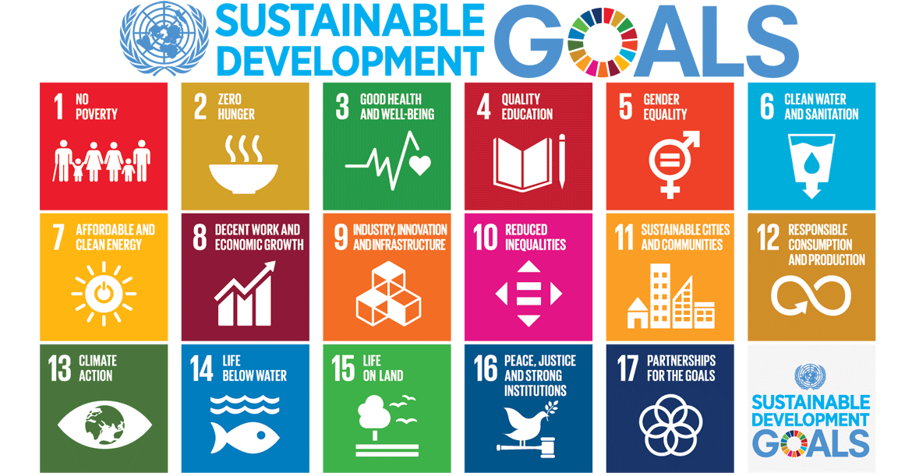

Slide 8
Design Thinking Process (Pierce et al., 2020)
Empathize
Field Trip – Immerse ourselves in the physical environment
Interviews – To better understand experiences, motivations, programming
Define the Problem
Create a problem statement
Ideate
Brainstorm potential solutions
Must align with one of 17 Goals of UN Sustainable Development
Prototype
Written proposal and presentation (Maps, renderings, proposed master plans, rationale)
Test
Not feasible for this project

Slide 9
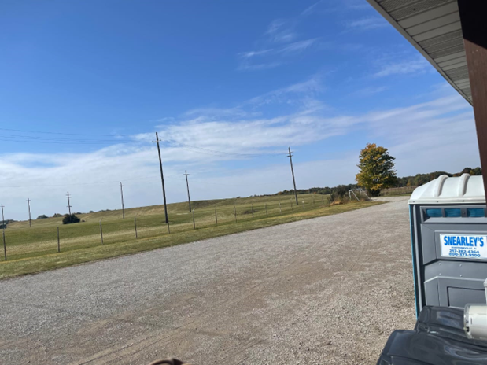
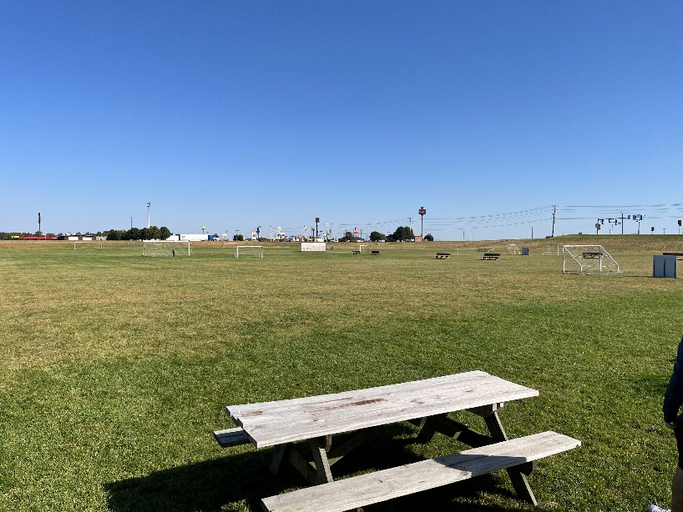
Marshall, IL
Fresh off Comprehensive Plan
Investing in Parks & Rec Opportunities
Community survey identified Indoor Rec Facilities & Bike/Walking Trails
260 acres … remediated former chemical production site

Slide 10
Timeline – 8 Weeks Course
Week 1
Field Trip
Activity – What is Sustainability?
Week 2
Activity – Master Plan Review
Week 3
Two Stakeholder Interviews
Week 4
Activity – Midpoint Check-in
Week 5
Nothing due
Week 6
In-Class Work Days
Week 7
Thanksgiving Break
Week 8
Presentations
Written Report
Activity – Reflection

Slide 11
Student Reflection Feedback
“My idea of sustainability changed quite a bit over the course of the project. I always thought that sustainability was more climate/nature focused. But over the course I learned that not only is sustainability climate focused, but also focuses on human and infrastructure as well.”
“Create a sense of understanding how everything you do can tie into sustainability.”
General theme of how important stakeholder interviews were to the process

Slide 12
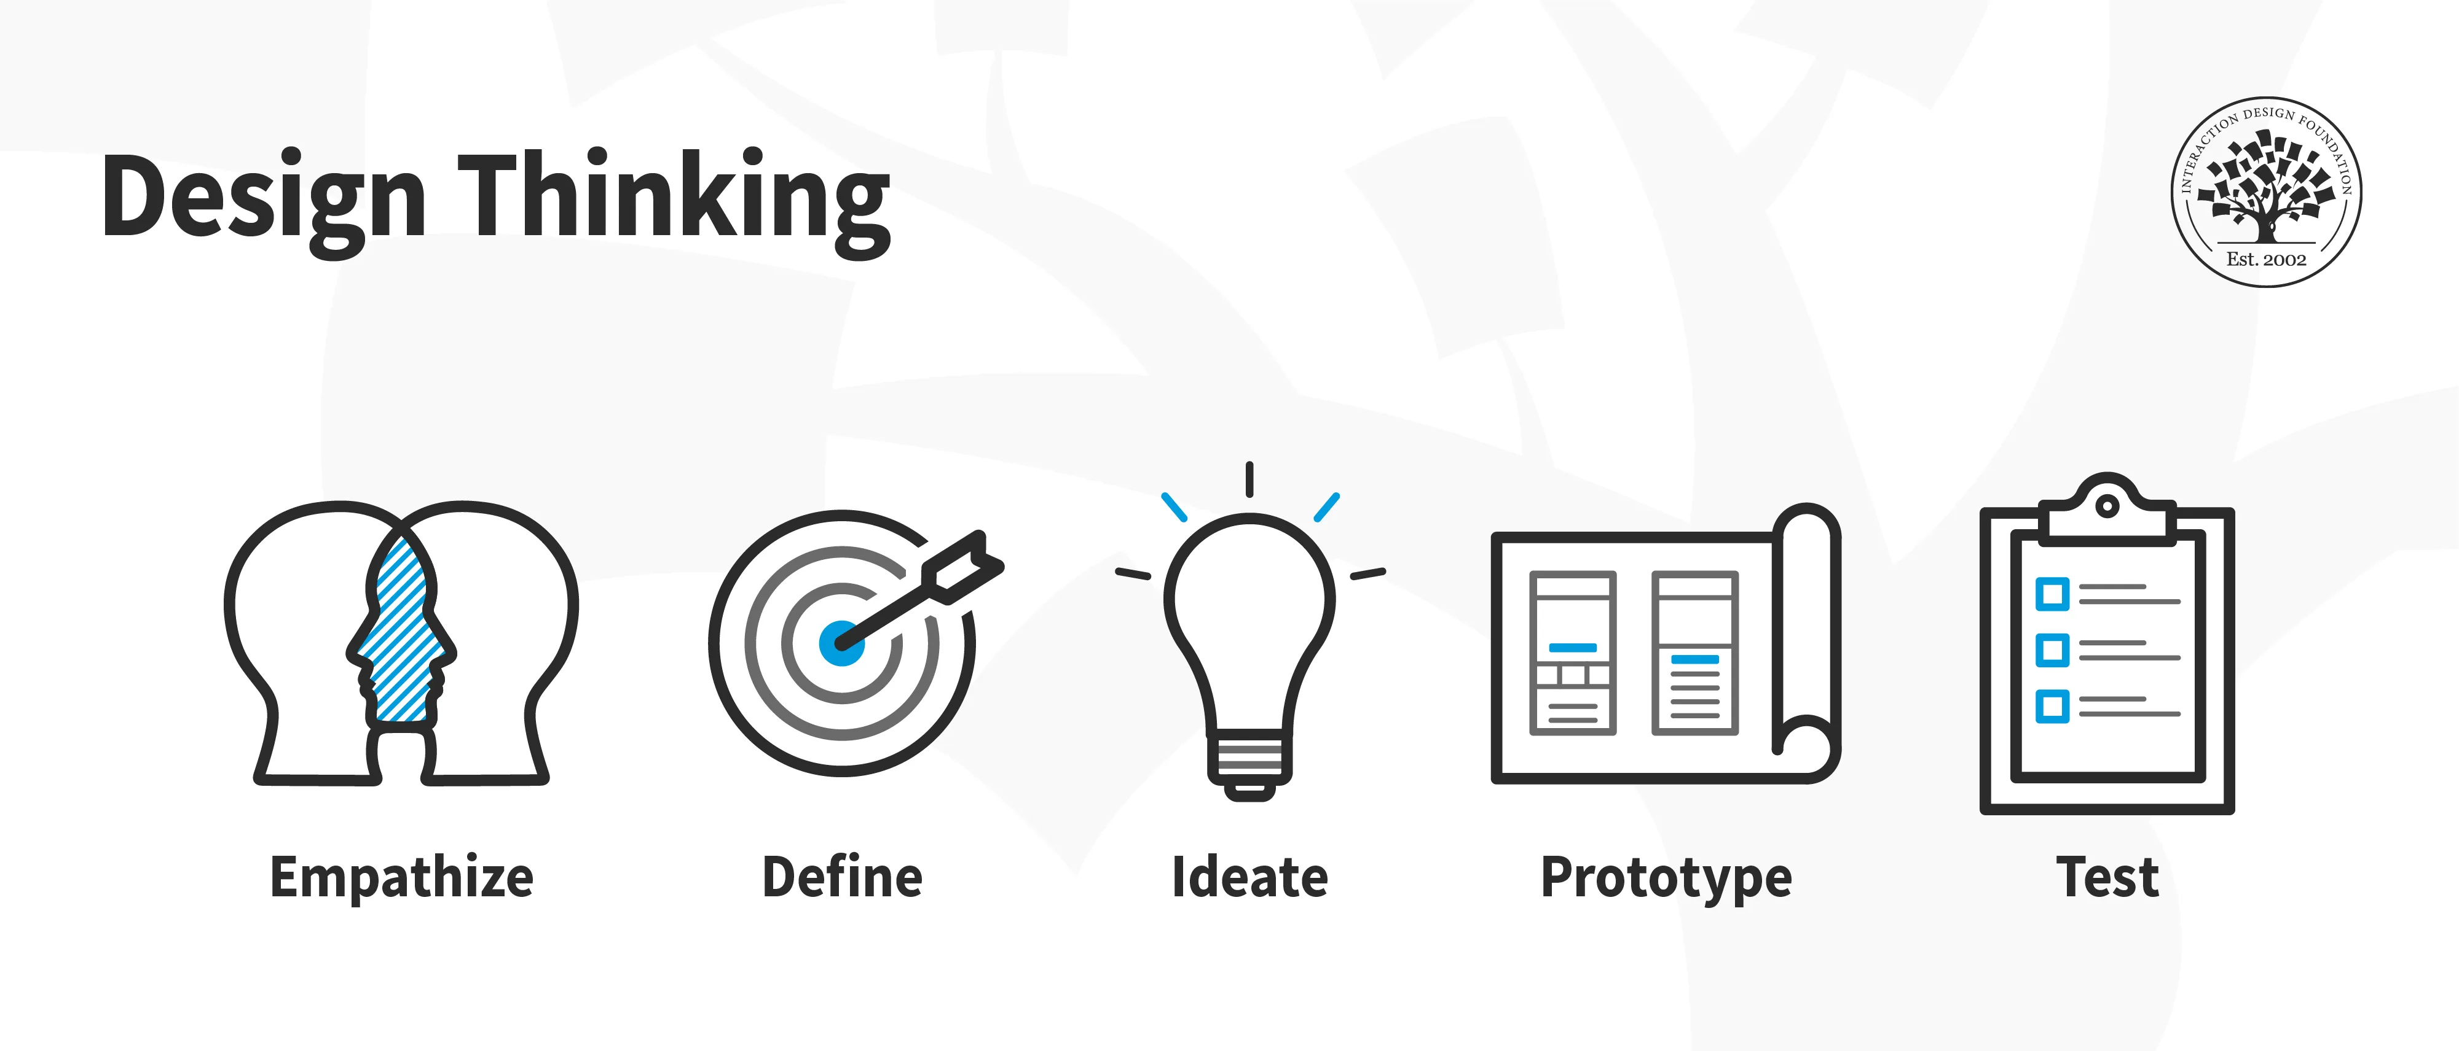
Integrating Project Into Course
Difficulty?
Teaching Materials
Strengths?
Implementing course concepts into real-world situation
Challenges?
Framing the Project
Tying feasible ideas to UN Sustainable Development Goals
Transportation and Meetings

Slide 13
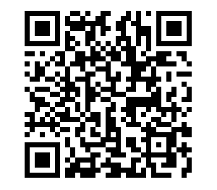
Questions? Comments? Concerns?
Craig Morehead
Indiana State University
craig.morehead@indstate.edu
Project Materials

