Slide 1
Corruptive Recruiting Practices Between Grassroots and Collegiate Programs
Mr. Michael Ross

Slide 2
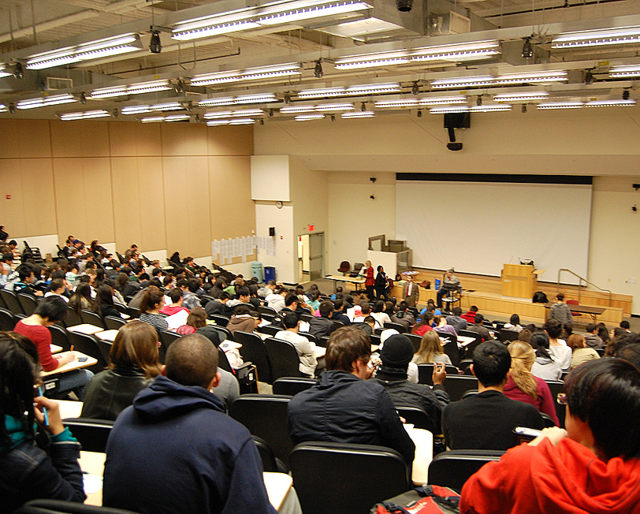
How do we research areas that have been studied? – Student perspective
Georgia College and State University – Introduction to Philosophy
Challenge current beliefs and ideals

Slide 3
Create Understanding From Holistic Approach
Deontology – what rules have been established to address the issue or topic at hand?
Teleological – what is the greatest good for the greatest number effected by the decision that needs to be made?
Existentialism – are the parties who make the decision in question acting within their own best or self interest?

Slide 4
Deontology – NCAA Rules and Regulations
What is expressly written and established as rules all stakeholders must abide by?
From an ethical standpoint, violating these written rules would be considered unethical.

Slide 5
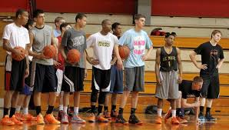
Teleological – Who is affected when violations occur?
What stakeholders must be considered when these violations become more common?
Does the greatest good for the greatest number simply refer to the team and their opponents?

Slide 6
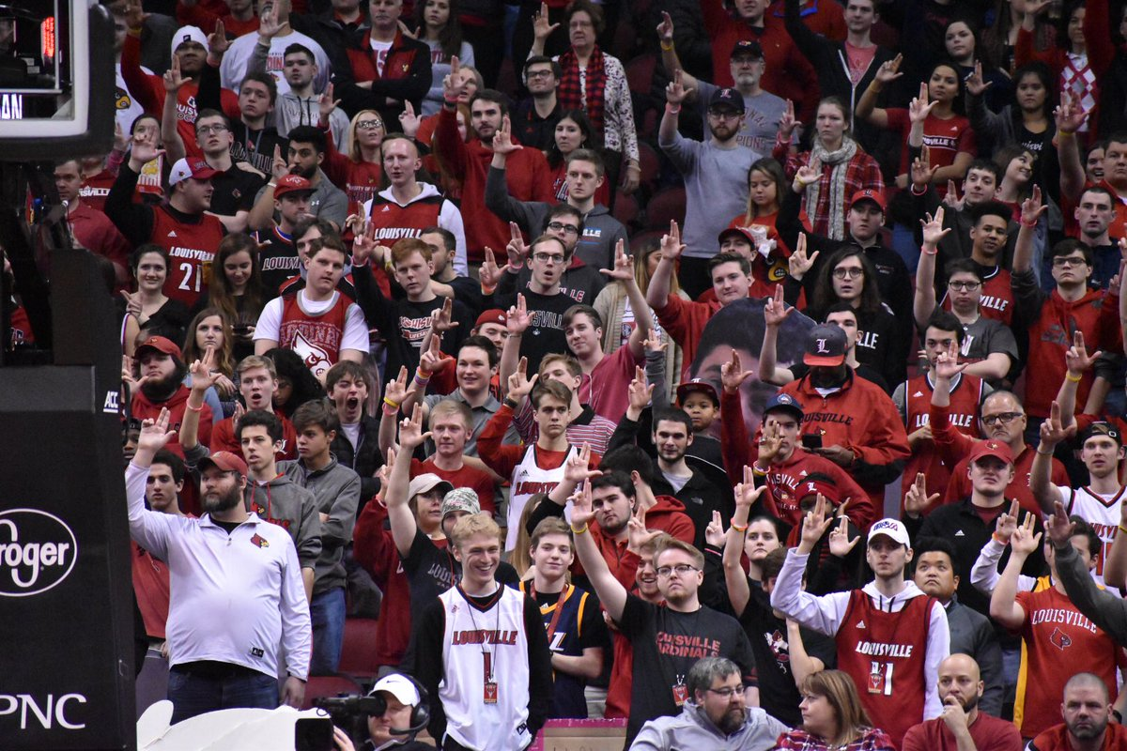
Existentialism – Why would programs risk violating these rules?
Are the programs acting in their own best interest?
What do 5-star recruits bring to the table for programs?
What is the likelihood of being caught?
What are the consequences of being caught?

Slide 7
The Goal: Examine given topics from all sides to better understand them fully.
Challenge biases and preconceived notions by researching topics from a holistic perspective
Offer multiple platforms of thought
Socratic Method – question why we believe the things we know to be true
Play Devil’s advocate to foster deeper thinking and reasoning.

