Slide 1
First-generation sport management students’ perceptions of holistic support in higher education.
Mark Vermillion: Wichita State University
Lauren Beasley: University of Tennessee
Bobby Berry: Wichita State University
Ricki Ellison: Wichita State University

Slide 2
Introduction
Purpose of today’s presentation:
1) Provide context and background
Summarize and connect P-I-E with current research
2) Examine Research Questions
Regarding individual characteristics, are there significant differences between first generation and non-first generation SMGT students’ self-esteem and academic self-efficacy (self) reports?
Are there statistically significant differences between first generation and non-first generation SMGT students’ perceptions of social support (peer/familial)?
Are there statistically significant differences between first generation and non-first generation SMGT students’ perceptions of university support?
3) Discuss and contextualize results

Slide 3
Previous Literature
Defining 1st Gen students:
According to Wichita State University:
“A first-generation college student is defined as a student whose parent(s)/legal guardian(s) have not completed a bachelor's degree. (This means that you are the first in your family to attend a four-year college/university to attain a bachelor's degree.)”
1st Gen Student experiences
Not monolithic & highly variegated
Factors impacting 1st Gen student success:
Individual (personal characteristics, factors)
Social (peer and/or parental support)
Environmental (faculty and/or on-campus support)

Slide 4
Previous Literature
Social Support
GPA, graduation (Baker 2013)
Peer and/or Parental Support
Financial, encouragement, logistical and/or academic assistance (Schneider & Ward, 2003)
Individual Characteristics
Motivation, self-esteem, academic self-efficacy (Dennis, Phinney, & Chuateco, 2005; Falcon 2015)
On-campus/University Support
Faculty and on-campus programming and/or resources (Cheng & Starks, 2002; Santo & Reigadas, 2002)

Slide 5
Connecting theoretical framework: Ecological Systems Theory
Bronfenbrenner (1974; 1994)
Five Systems that impact individual:
Microsystems
Mesosytems
Exosystems
Macrosystems
Chronosystems

Slide 6
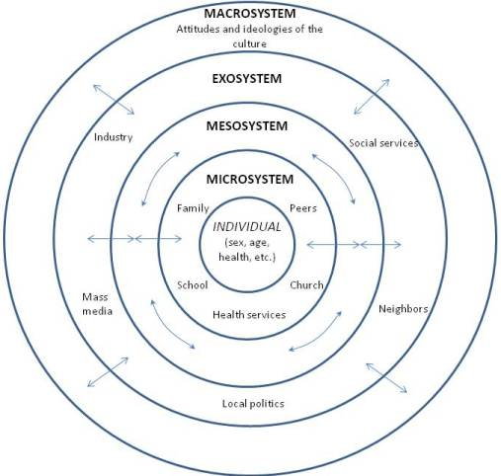

Slide 7
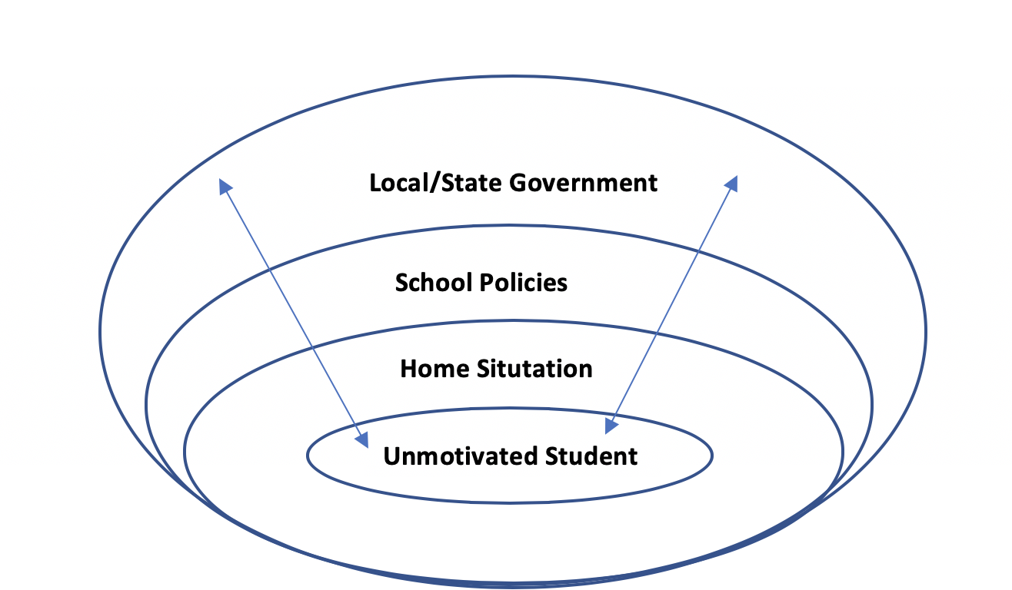
Person-In-Environment (P-I-E) Assessment/Intervention Model
Understanding and assessing the individual student and their behavior in light of their of environment

Slide 8
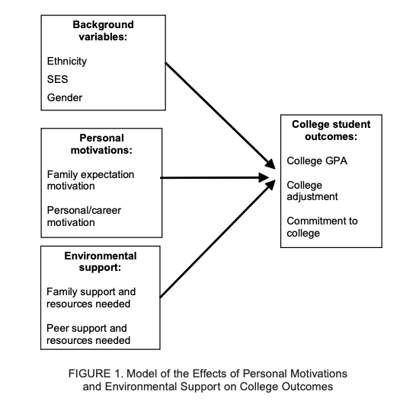
Dennis, Phinney, & Chuateco (2005): Example of how P-I-E connects to current, salient research

Slide 9
Research Questions
Purpose
Specifically,
Regarding individual characteristics, are there significant differences between first generation and non-first generation SMGT students’ reports of self-esteem and academic self-efficacy?
Are there statistically significant differences between first generation and non-first generation SMGT students’ perceptions of social support (peer/familial)?
Are there statistically significant differences between first generation and non-first generation SMGT students’ perceptions of university support?

Slide 10
Methods
Survey Instrument: IRB Approved, electronic distribution during fall 2019 among a 100, 300, and 400-level undergraduate courses
N=128
Scales
Rosenberg Self-Esteem Scale (Rosenberg, 1965) ($∝$= *0.48, $\overline{x}$=18.1, ranges 0 to 30, SD=2.70)
General Academic Self-Efficacy Scale (Torre, 2006) ($∝$= 0.82, $\overline{x}$=19.3, ranges 8 to 56, SD=6.54)
Family Support Scale ($∝$= 0.71, $\overline{x}$=11.1, ranges 6 to 24, SD=3.31)
Peer Support Scale ($∝$= 0.70, $\overline{x}$=13.1, ranges 6 to 24, SD=3.40)
University Support and Structure Scale ($∝$= 0.74, $\overline{x}$=45.3, ranges 21 to 105, SD=3.79) (Wintre, Gates, Pancer, Pratt, Polivy, Bernie-Lefcovitch & Adams, 2009)
* Wongpakaran & Wongpakaran (2012) note RSES is one of the most widely used self-esteem instruments, but the negatively worded items may cause respondent confusion; thereby, decreasing reliability.

Slide 11
Results: Demographics
*Age:
Mean: 20.9 yrs.
Mode: 20 yrs.
Gender:
Male: 70.3%
Female: 29.7%
Race:
African-American: 14.1%
White: 81.3%
Ethnicity:
Non-Hispanic: 83.6%
Class:
Fresh: 28.9%
Soph: 28.1%
Jr: 24.2%
Sr: 18.8%
GPA:
3.5-4.0: 10.9%
3.0-3.49: 48.4%
2.5-2.99: 32%
2.0-2.49: 7.8%
1st Gen: 44.5%
*NOTE: 77.4% of sample was 19-21 y/o

Slide 12
Results: Demographics for 1st Gen Students
Within this sample, our 1st Gen students (n=57) tend to be:
About 20 years old
77.2% of the sample self-reported being a Fresh. or Soph. in school.
Male (64.9%)
White (82.5%)
Non-Hispanic (73.7%)
A good student
93% self-reported a GPA between 2.5 and 3.49
WSU’s typical 1st Gen profile:
White (non-Hispanic), females from households earning over $75,000
Excellent (e.g. GPA) students that graduate in less than 4 years

Slide 13
Results: Regarding individual characteristics, are there significant differences between first generation and non-first generation SMGT students’ reports of self-esteem and academic self-efficacy?
Means differences analysis: independent samples t-test
Self-esteem (1st Gen: n=57; Non-1st Gen: n=71)
There was a statistically significant difference in self-esteem scores between 1st Gen ($\overline{x}$=16.9, SD= 2.5) and non-1st Gen students ($\overline{x}$=18.8, SD= 2.6); t(127)= -4.087, p = .000
Academic self-efficacy (1st Gen: n=57; Non-1st Gen: n=71)
There was not a statistically significant difference in academic self-efficacy scores between 1st Gen ($\overline{x}$=19.0, SD= 6.7) and non-1st Gen students ($\overline{x}$=19.5, SD= 6.3); t(126)= -.403, p = .685
NOTE: reports of self-esteem were above 15, which is the bifurcation point for suggesting low self-esteem; academic self-efficacy was well below scale’s midpoint for both groups

Slide 14
Results: Are there statistically significant differences between first generation and non-first generation SMGT students’ perceptions of social support (peer/familial)?
Means differences analysis: independent samples t-test
Family Support (1st Gen: n=57; Non-1st Gen: n=69)
There was not a statistically significant difference in reports of family support between 1st Gen ($\overline{x}$=11.1, SD= 3.4) and non-1st Gen students ($\overline{x}$=11.0, SD= 3.2); t(124)= .268, p = .790
Peer Support (1st Gen: n=56; Non-1st Gen: n=69)
There was not a statistically significant difference in reports of peer support between 1st Gen ($\overline{x}$=12.8, SD= 3.6) and non-1st Gen students ($\overline{x}$=13.4, SD= 3.2); t(124)= -1.218, p = .226

Slide 15
Results: Are there statistically significant differences between first generation and non-first generation SMGT students’ perceptions of university support?
Means differences analysis: independent sample t-test
University Support (1st Gen: n=57; Non-1st Gen: n=71)
There was a statistically significant difference in perceptions of university support between 1st Gen ($\overline{x}$=44.0, SD= 3.5) and non-1st Gen students ($\overline{x}$=46.4, SD= 3.6); t(126)= -3.678, p = .000

Slide 16
Discussion & Connection
Issues of mental and behavioral health concerns are increasing across campuses, workplaces, and society
Both groups of students had low self-reports of both self-esteem and academic self-efficacy.
Both groups had positive perceptions of family and peer support.
Runs contrary to 1st Gen students literature.
1st Gen students perceived university support differently
Mirrors increase in 1st Gen-specific programming and support efforts
WSU Example

Slide 17
Conclusion
Purpose: discuss and examine 1st Gen sport management students perceptions of support.
N=128, which is 56% of undergraduate SMGT population at WSU
More research can be done:
Larger sample
Comparative analysis with other programs/schools
Multivariate analysis examining factors influencing first generation students perceptions of university support
Focus on departmental efforts to holistically support all students, while acknowledging that not all students are homogenous in need(s).

